Slide 1


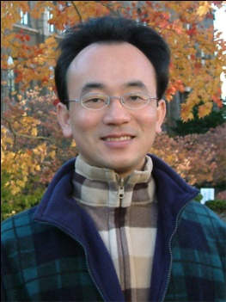
自然語言處理核心技術 與文字探勘 (Core Technologies of Natural Language Processing and Text Mining)
Min-Yuh Day
戴敏育
Associate Professor
副教授
Institute of Information Management, National Taipei University
國立臺北大學 資訊管理研究所
https://web.ntpu.edu.tw/~myday
2020-09-18

Slide 2



戴敏育 博士 (Min-Yuh Day, Ph.D.)
國立台北大學 資訊管理研究所 副教授
中央研究院 資訊科學研究所 訪問學人
國立台灣大學 資訊管理 博士
Publications Co-Chairs, IEEE/ACM International Conference on Advances in Social Networks Analysis and Mining (ASONAM 2013- )
Program Co-Chair, IEEE International Workshop on Empirical Methods for Recognizing Inference in TExt (IEEE EM-RITE 2012- )
Publications Chair, The IEEE International Conference on Information Reuse and Integration (IEEE IRI)

Slide 3
Topics
自然語言處理核心技術與文字探勘 (Core Technologies of Natural Language Processing and Text Mining)
人工智慧文本分析基礎與應用 (Artificial Intelligence for Text Analytics: Foundations and Applications)
文本表達特徵工程 (Feature Engineering for Text Representation)
語意分析和命名實體識別 (Semantic Analysis and Named Entity Recognition; NER)
深度學習和通用句子嵌入模型 (Deep Learning and Universal Sentence-Embedding Models)
問答系統與對話系統 (Question Answering and Dialogue Systems)

Slide 4
Outline
Text Analytics and Text Mining
Natural Language Processing (NLP)
Text Analytics with Python

Slide 5
Text Analytics (TA)

Slide 6
Text Mining (TM)

Slide 7
Natural Language Processing (NLP)

Slide 8
Artificial Intelligence (AI)

Slide 9
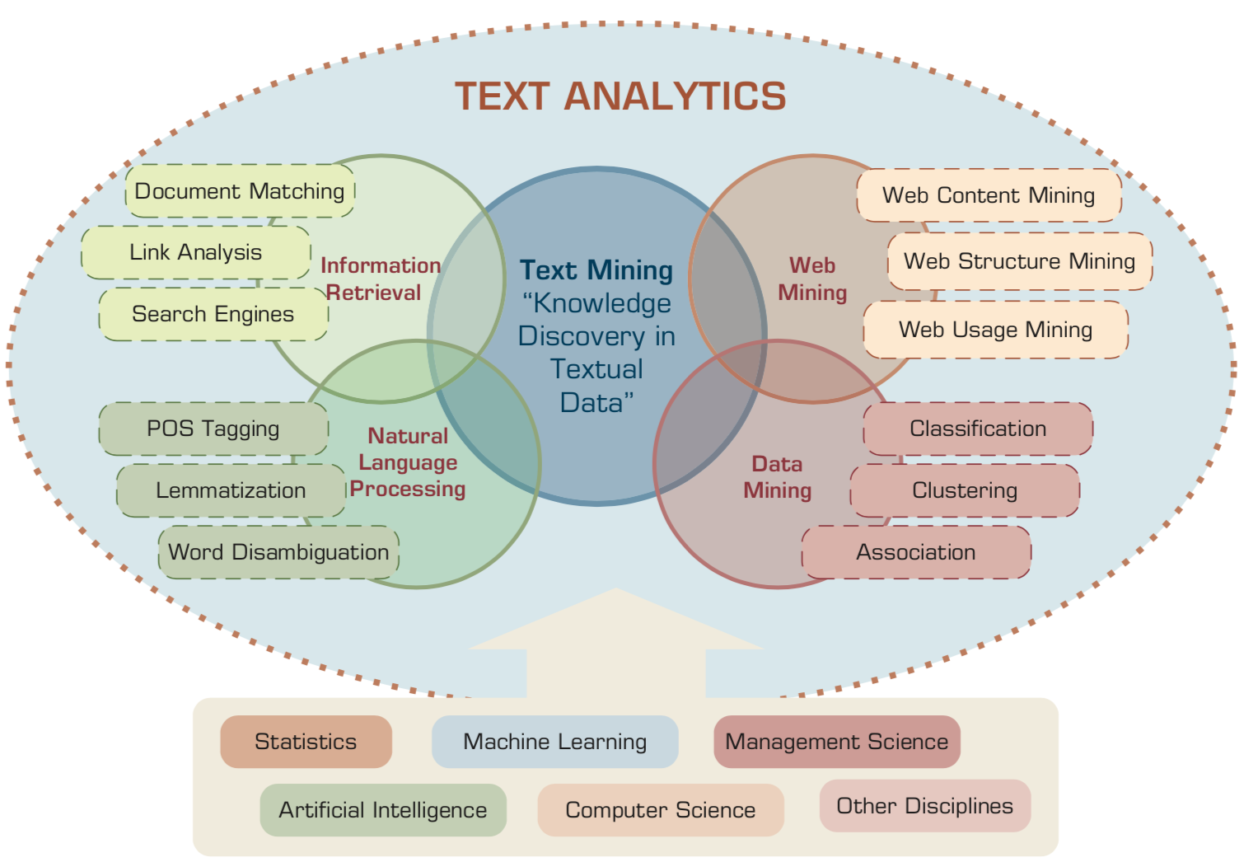
Text Analytics and Text Mining
Source: Ramesh Sharda, Dursun Delen, and Efraim Turban (2017), Business Intelligence, Analytics, and Data Science: A Managerial Perspective, 4th Edition, Pearson

Slide 10
AI, Big Data, Cloud Computing Evolution of Decision Support, Business Intelligence, and Analytics
AI
AI
Cloud Computing
Big Data
DM
BI
TM
Source: Ramesh Sharda, Dursun Delen, and Efraim Turban (2017), Business Intelligence, Analytics, and Data Science: A Managerial Perspective, 4th Edition, Pearson

Slide 11
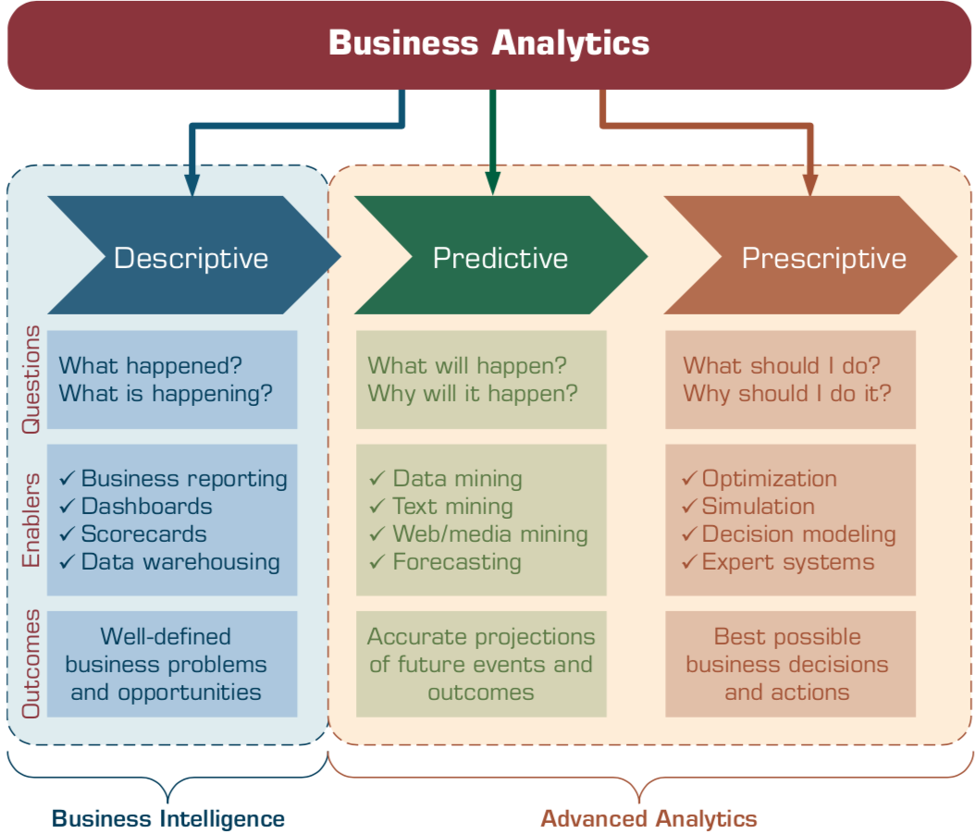
Business Analytics
Source: Ramesh Sharda, Dursun Delen, and Efraim Turban (2017), Business Intelligence, Analytics, and Data Science: A Managerial Perspective, 4th Edition, Pearson

Slide 12
Text Analytics and Text Mining

Slide 13
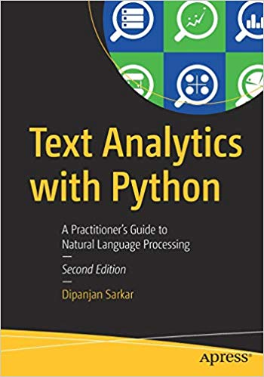
Dipanjan Sarkar (2019), Text Analytics with Python: A Practitioner’s Guide to Natural Language Processing, Second Edition. APress.
Source: https://www.amazon.com/Text-Analytics-Python-Practitioners-Processing/dp/1484243536

Slide 14

Benjamin Bengfort, Rebecca Bilbro, and Tony Ojeda (2018), Applied Text Analysis with Python: Enabling Language-Aware Data Products with Machine Learning, O’Reilly.
Source: https://www.amazon.com/Applied-Text-Analysis-Python-Language-Aware/dp/1491963042

Slide 15
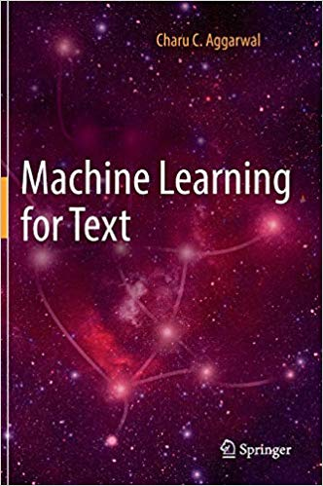
Charu C. Aggarwal (2018), Machine Learning for Text, Springer
Source: https://www.amazon.com/Machine-Learning-Text-Charu-Aggarwal/dp/3319735306

Slide 16

Gabe Ignatow and Rada F. Mihalcea (2017), An Introduction to Text Mining: Research Design, Data Collection, and Analysis, SAGE Publications.
Source: https://www.amazon.com/Introduction-Text-Mining-Research-Collection/dp/1506337007

Slide 17
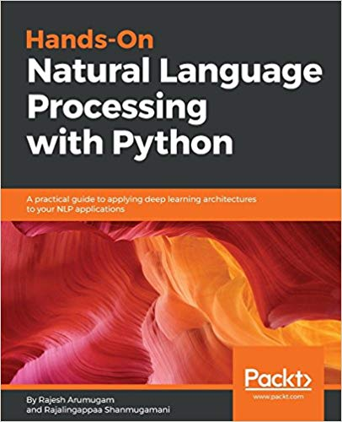
Rajesh Arumugam (2018), Hands-On Natural Language Processing with Python: A practical guide to applying deep learning architectures to your NLP applications, Packt
https://www.amazon.com/Hands-Natural-Language-Processing-Python/dp/178913949X

Slide 18
Text Analytics
Text Analytics = Information Retrieval + Information Extraction + Data Mining + Web Mining
Text Analytics = Information Retrieval + Text Mining
Source: Ramesh Sharda, Dursun Delen, and Efraim Turban (2017), Business Intelligence, Analytics, and Data Science: A Managerial Perspective, 4th Edition, Pearson

Slide 19
Text Mining
Text Data Mining
Knowledge Discovery in Textual Databases
Source: Ramesh Sharda, Dursun Delen, and Efraim Turban (2017), Business Intelligence, Analytics, and Data Science: A Managerial Perspective, 4th Edition, Pearson

Slide 20
Text Mining Technologies
Statistics
Machine Learning
Pattern Recognition
Database Systems
Visualization
Text Mining
Natural Language Processing
Algorithms
Information Retrieval
Applications
High-performance Computing
Adapted from: Jiawei Han and Micheline Kamber (2011), Data Mining: Concepts and Techniques, Third Edition, Elsevier

Slide 21
Application Areas of Text Mining
Information extraction
Topic tracking
Summarization
Categorization
Clustering
Concept linking
Question answering
Source: Ramesh Sharda, Dursun Delen, and Efraim Turban (2017), Business Intelligence, Analytics, and Data Science: A Managerial Perspective, 4th Edition, Pearson

Slide 22
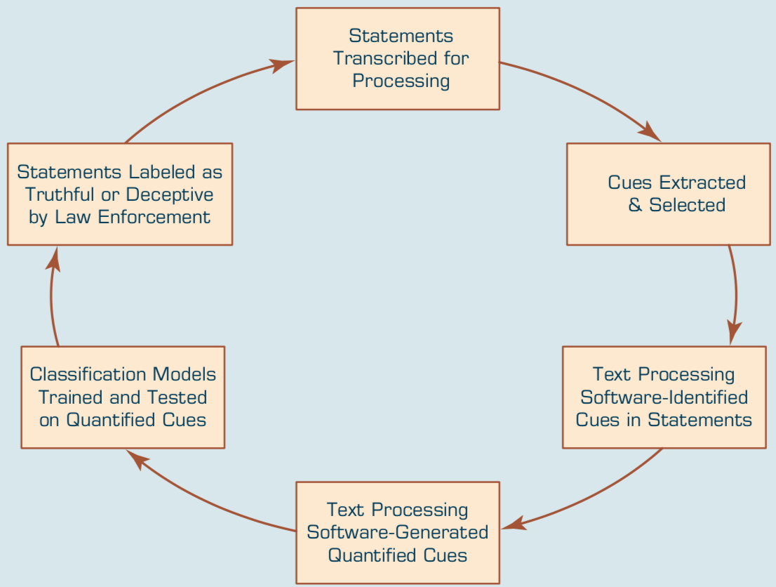
Text-Based Deception-Detection Process
Source: Ramesh Sharda, Dursun Delen, and Efraim Turban (2017), Business Intelligence, Analytics, and Data Science: A Managerial Perspective, 4th Edition, Pearson

Slide 23
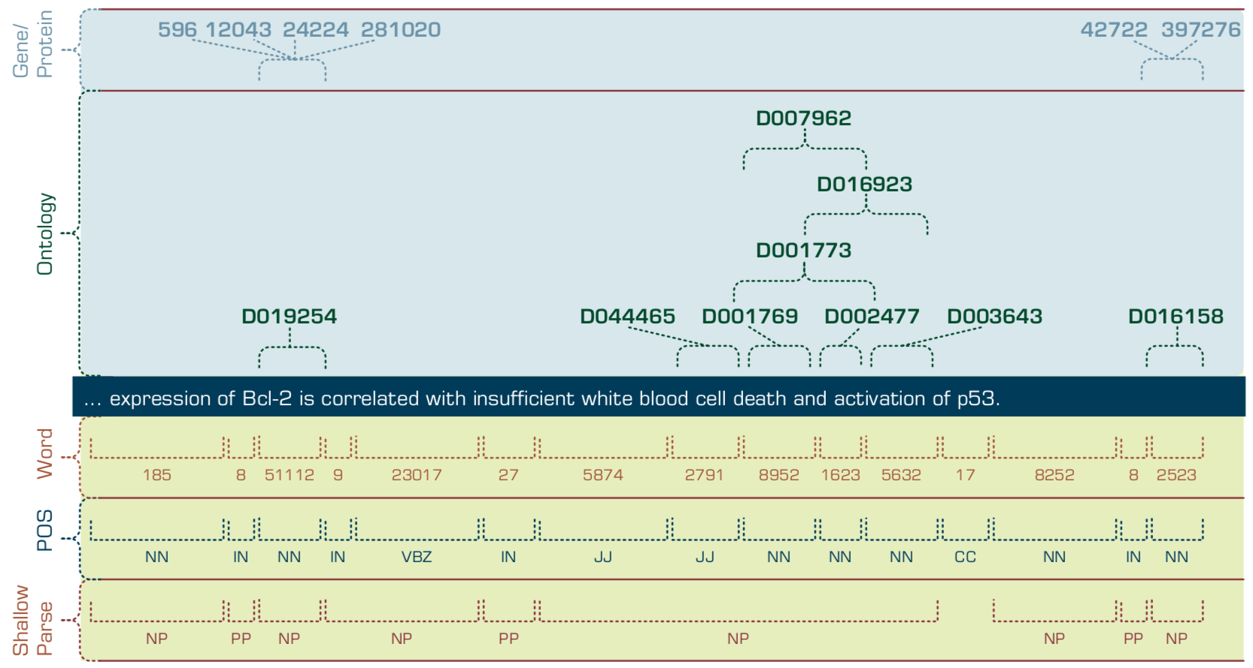
Multilevel Analysis of Text for Gene/Protein Interaction Identification
Source: Ramesh Sharda, Dursun Delen, and Efraim Turban (2017), Business Intelligence, Analytics, and Data Science: A Managerial Perspective, 4th Edition, Pearson

Slide 24
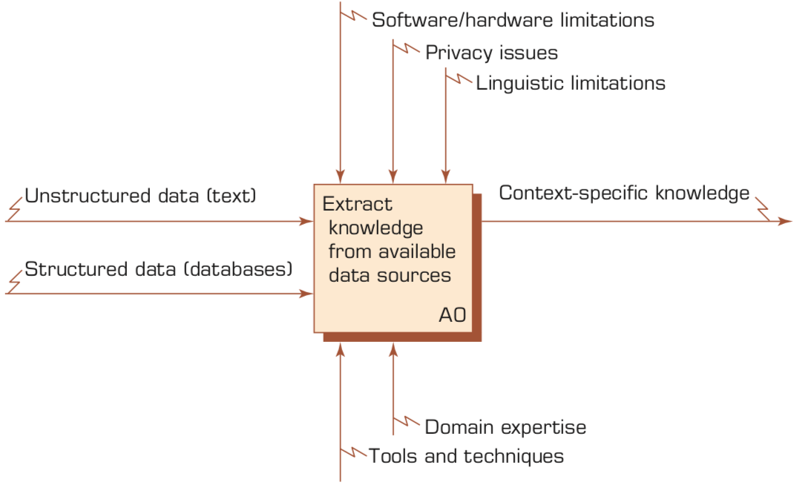
Context Diagram for the Text Mining Process
Source: Ramesh Sharda, Dursun Delen, and Efraim Turban (2017), Business Intelligence, Analytics, and Data Science: A Managerial Perspective, 4th Edition, Pearson

Slide 25
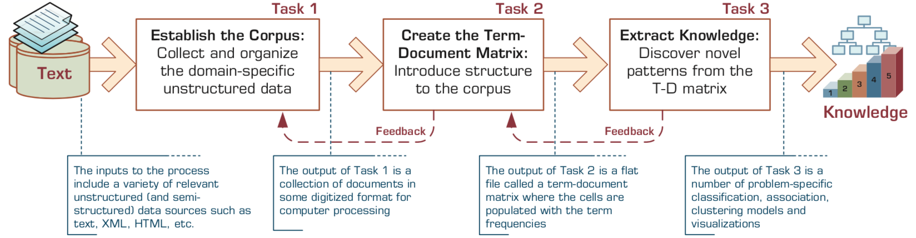
The Three-Step/Task Text Mining Process
Source: Ramesh Sharda, Dursun Delen, and Efraim Turban (2017), Business Intelligence, Analytics, and Data Science: A Managerial Perspective, 4th Edition, Pearson

Slide 26
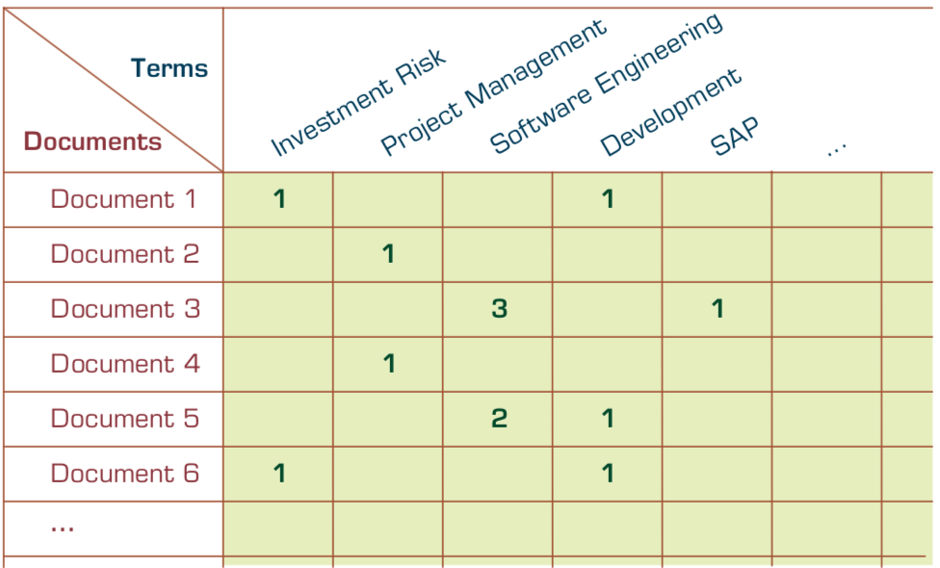
Term–Document Matrix
Source: Ramesh Sharda, Dursun Delen, and Efraim Turban (2017), Business Intelligence, Analytics, and Data Science: A Managerial Perspective, 4th Edition, Pearson

Slide 27


Emotions
Love
Anger
Joy
Sadness
Surprise
Fear
Source: Bing Liu (2011) , “Web Data Mining: Exploring Hyperlinks, Contents, and Usage Data,” Springer, 2nd Edition,

Slide 28
Example of Opinion: review segment on iPhone
“I bought an iPhone a few days ago.
It was such a nice phone.
The touch screen was really cool.
The voice quality was clear too.
However, my mother was mad with me as I did not tell her before I bought it.
She also thought the phone was too expensive, and wanted me to return it to the shop. … ”
Source: Bing Liu (2011) , “Web Data Mining: Exploring Hyperlinks, Contents, and Usage Data,” Springer, 2nd Edition,

Slide 29
Example of Opinion: review segment on iPhone
“(1) I bought an iPhone a few days ago.
(2) It was such a nice phone.
(3) The touch screen was really cool.
(4) The voice quality was clear too.
(5) However, my mother was mad with me as I did not tell her before I bought it.
(6) She also thought the phone was too expensive, and wanted me to return it to the shop. … ”
+Positive Opinion
-Negative Opinion
Source: Bing Liu (2011) , “Web Data Mining: Exploring Hyperlinks, Contents, and Usage Data,” Springer, 2nd Edition,

Slide 30
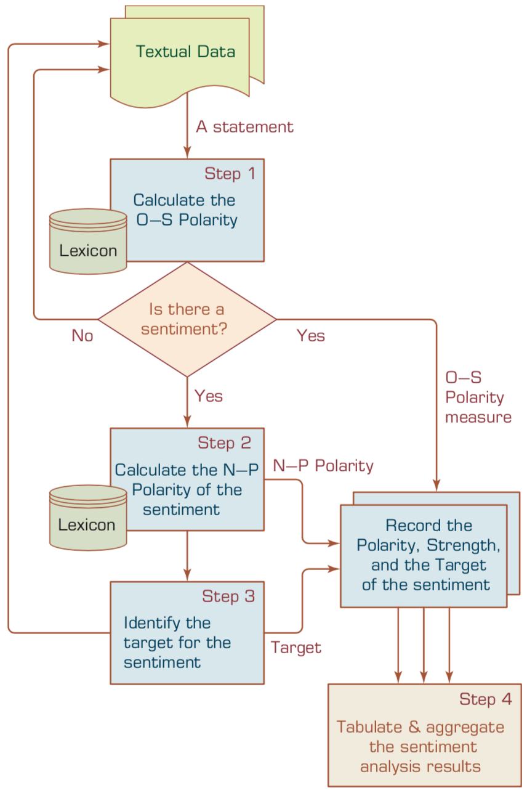
A Multistep Process to Sentiment Analysis
Source: Ramesh Sharda, Dursun Delen, and Efraim Turban (2017), Business Intelligence, Analytics, and Data Science: A Managerial Perspective, 4th Edition, Pearson

Slide 31
Sentiment Analysis
Subjectivity Classification
Polarity Determination
Approaches
Machine Learning based
Sentiment Classification
Vagueness resolution in opinionated text
Lexicon based
Sentiment Analysis
Review Usefulness Measurement
Multi- & Cross- Lingual SC
Hybrid approaches
Opinion Spam Detection
Cross-domain SC
Lexicon Creation
Ontology based
Tasks
Non-Ontology based
Aspect Extraction
Application
Source: Kumar Ravi and Vadlamani Ravi (2015), "A survey on opinion mining and sentiment analysis: tasks, approaches and applications." Knowledge-Based Systems, 89, pp.14-46.

Slide 32
Sentiment Classification Techniques
Decision Tree Classifiers
Support Vector Machine (SVM)
Supervised Learning
Neural Network (NN
Machine Learning Approach
Linear Classifiers
Deep Learning (DL)
Rule-based Classifiers
Naïve Bayes (NB)
Sentiment Analysis
Unsupervised Learning
Probabilistic Classifiers
Bayesian Network (BN)
Dictionary-based Approach
Maximum Entropy (ME)
Lexicon-based Approach
Statistical
Corpus-based Approach
Semantic
Source: Jesus Serrano-Guerrero, Jose A. Olivas, Francisco P. Romero, and Enrique Herrera-Viedma (2015), "Sentiment analysis: A review and comparative analysis of web services," Information Sciences, 311, pp. 18-38.

Slide 33
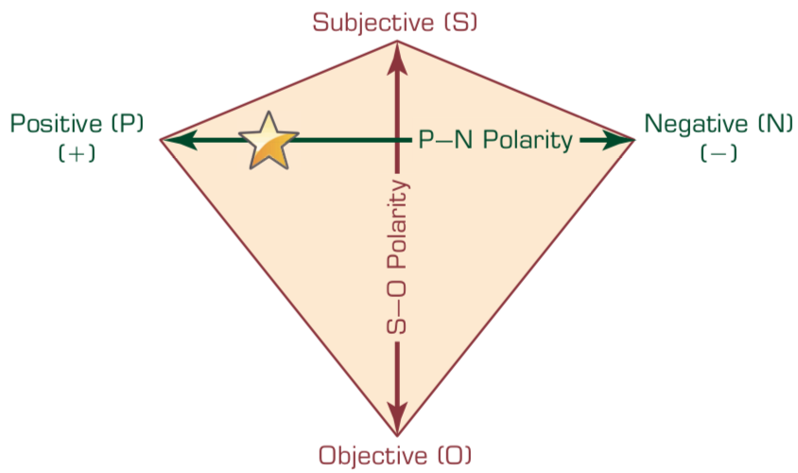
P–N Polarity and S–O Polarity Relationship
Source: Ramesh Sharda, Dursun Delen, and Efraim Turban (2017), Business Intelligence, Analytics, and Data Science: A Managerial Perspective, 4th Edition, Pearson

Slide 34
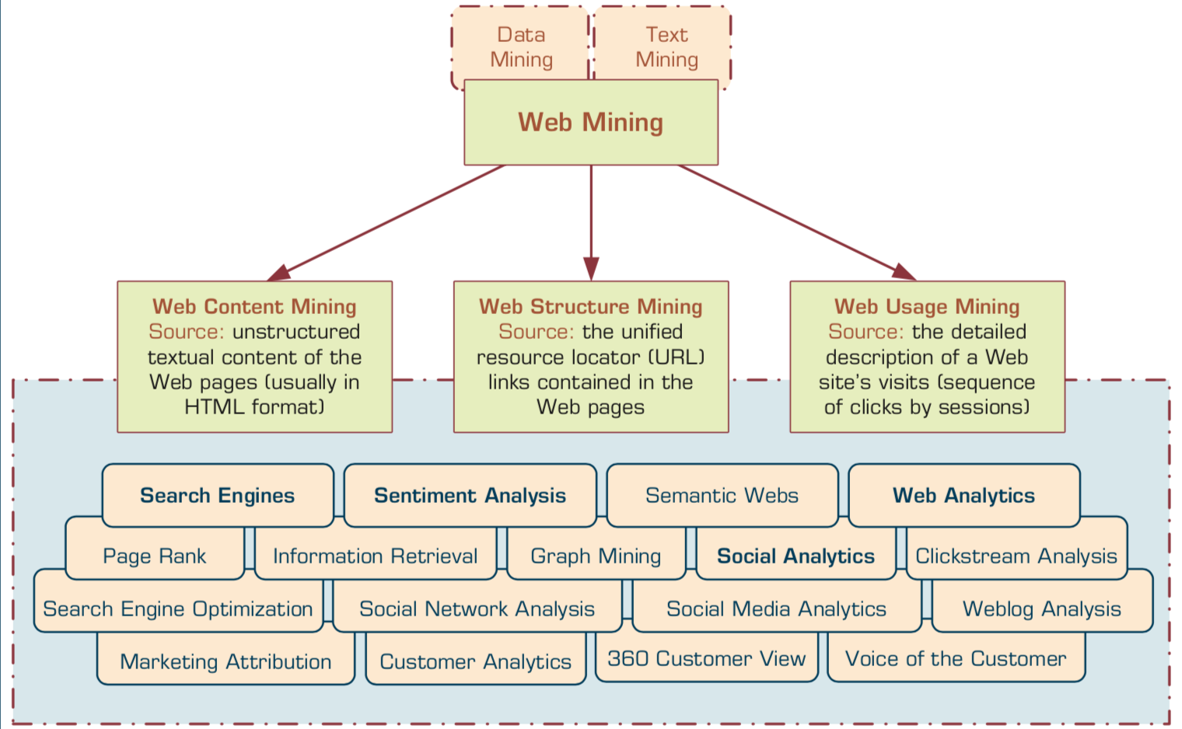
Taxonomy of Web Mining
Source: Ramesh Sharda, Dursun Delen, and Efraim Turban (2017), Business Intelligence, Analytics, and Data Science: A Managerial Perspective, 4th Edition, Pearson

Slide 35
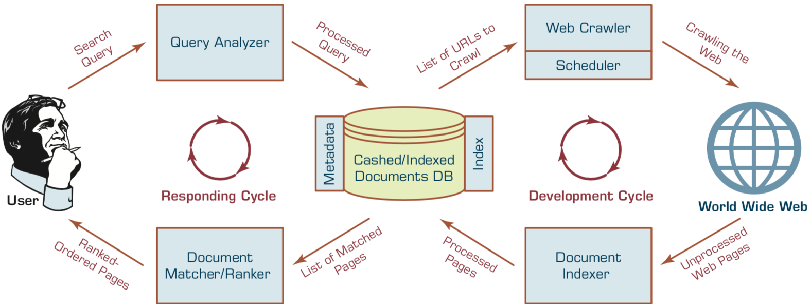
Structure of a Typical Internet Search Engine
Source: Ramesh Sharda, Dursun Delen, and Efraim Turban (2017), Business Intelligence, Analytics, and Data Science: A Managerial Perspective, 4th Edition, Pearson

Slide 36
Web Usage Mining (Web Analytics)
Web usage mining (Web analytics) is the extraction of useful information from data generated through Web page visits and transactions.
Clickstream Analysis
Source: Ramesh Sharda, Dursun Delen, and Efraim Turban (2017), Business Intelligence, Analytics, and Data Science: A Managerial Perspective, 4th Edition, Pearson

Slide 37
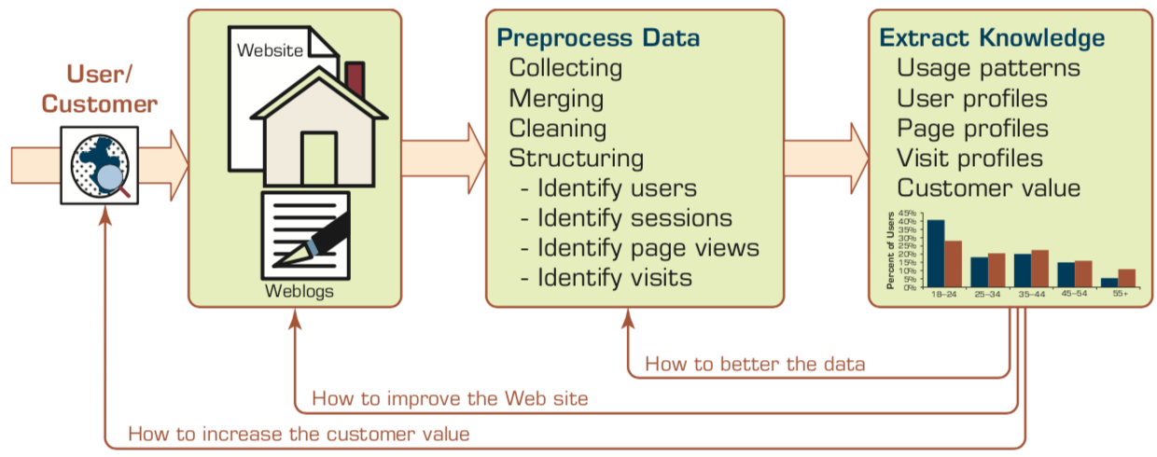
Extraction of Knowledge from Web Usage Data
Source: Ramesh Sharda, Dursun Delen, and Efraim Turban (2017), Business Intelligence, Analytics, and Data Science: A Managerial Perspective, 4th Edition, Pearson

Slide 38
Social Analytics
Social analytics is defined as monitoring, analyzing, measuring and interpreting digital interactions and relationships of people, topics, ideas and content.
Source: Ramesh Sharda, Dursun Delen, and Efraim Turban (2017), Business Intelligence, Analytics, and Data Science: A Managerial Perspective, 4th Edition, Pearson

Slide 39
Branches of Social Analytics
Social Network Analysis (SNA)
Social Analytics
Social Media Analytics
Source: Ramesh Sharda, Dursun Delen, and Efraim Turban (2017), Business Intelligence, Analytics, and Data Science: A Managerial Perspective, 4th Edition, Pearson

Slide 40
Text Mining Technologies

Slide 41
Natural Language Processing (NLP)
Text Mining (TM)

Slide 42
Text Mining Concepts
85-90 percent of all corporate data is in some kind of unstructured form (e.g., text)
Unstructured corporate data is doubling in size every 18 months
Tapping into these information sources is not an option, but a need to stay competitive
Answer: text mining
A semi-automated process of extracting knowledge from unstructured data sources
a.k.a. text data mining or knowledge discovery in textual databases
Source: Turban et al. (2011), Decision Support and Business Intelligence Systems

Slide 43
Text mining
Text Data Mining
Intelligent Text Analysis
Knowledge-Discovery in Text (KDT)
Source: Vishal Gupta and Gurpreet S. Lehal (2009), "A survey of text mining techniques and applications," Journal of emerging technologies in web intelligence, vol. 1, no. 1, pp. 60-76.

Slide 44
Text Mining (text data mining)
the process of deriving high-quality information from text
http://en.wikipedia.org/wiki/Text_mining

Slide 45
Text Mining: the process of extracting interesting and non-trivial information and knowledge from unstructured text.
Source: Vishal Gupta and Gurpreet S. Lehal (2009), "A survey of text mining techniques and applications," Journal of emerging technologies in web intelligence, vol. 1, no. 1, pp. 60-76.

Slide 46
Text Mining: discovery by computer of new, previously unknown information, by automatically extracting information from different written resources.
Source: Vishal Gupta and Gurpreet S. Lehal (2009), "A survey of text mining techniques and applications," Journal of emerging technologies in web intelligence, vol. 1, no. 1, pp. 60-76.

Slide 47
An example of Text Mining
Knowledge
Analyze Text
Management Information System
Information Extraction
Classification
Summarization
Retrieve and preprocess document
Clustering
Document Collection
Source: Vishal Gupta and Gurpreet S. Lehal (2009), "A survey of text mining techniques and applications," Journal of emerging technologies in web intelligence, vol. 1, no. 1, pp. 60-76.

Slide 48
Overview of Information Extraction based Text Mining Framework
Text Data Mining
Text
Text
DB
Text
Information Extraction
Data Mining
Rule
Source: Vishal Gupta and Gurpreet S. Lehal (2009), "A survey of text mining techniques and applications," Journal of emerging technologies in web intelligence, vol. 1, no. 1, pp. 60-76.

Slide 49
Natural Language Processing (NLP)
Natural language processing (NLP) is an important component of text mining and is a subfield of artificial intelligence and computational linguistics.
Source: Ramesh Sharda, Dursun Delen, and Efraim Turban (2017), Business Intelligence, Analytics, and Data Science: A Managerial Perspective, 4th Edition, Pearson

Slide 50
Natural Language Processing (NLP) and Text Mining
Raw text
Sentence Segmentation
Tokenization
Part-of-Speech (POS)
Stop word removal
word’s stem
am → am
having → hav
word’s lemma
am → be
having → have
Stemming / Lemmatization
Dependency Parser
String Metrics & Matching
Source: Nitin Hardeniya (2015), NLTK Essentials, Packt Publishing; Florian Leitner (2015), Text mining - from Bayes rule to dependency parsing

Slide 51
Text Summarization
Text Input
Dictionary / Thesaurus
Pre-processing
Text Structure Analysis
Word Segmentation
Occurrence Statistic
POS Tagging
Keyword Extraction
Weigh Words & Sentences
Sentences Selection
Rough Summary Generation
Smoothing
Summary Output
Source: Vishal Gupta and Gurpreet S. Lehal (2009), "A survey of text mining techniques and applications," Journal of emerging technologies in web intelligence, vol. 1, no. 1, pp. 60-76.

Slide 52
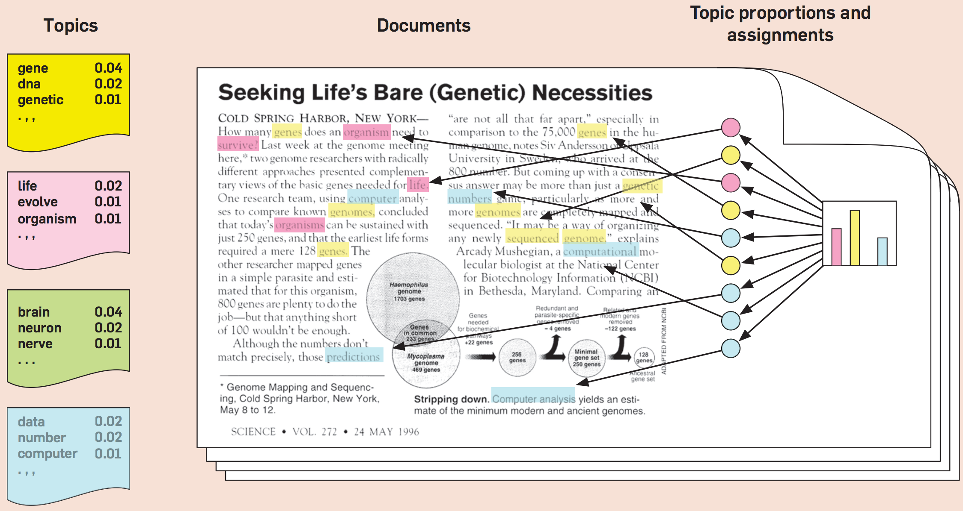
Topic Modeling
Source: Blei, David M. "Probabilistic topic models." Communications of the ACM 55, no. 4 (2012): 77-84.

Slide 53
Natural Language Processing (NLP)
Part-of-speech tagging
Text segmentation
Word sense disambiguation
Syntactic ambiguity
Imperfect or irregular input
Speech acts
Source: Ramesh Sharda, Dursun Delen, and Efraim Turban (2017), Business Intelligence, Analytics, and Data Science: A Managerial Perspective, 4th Edition, Pearson

Slide 54
NLP Tasks
Question answering
Automatic summarization
Natural language generation
Natural language understanding
Machine translation
Foreign language reading
Foreign language writing.
Speech recognition
Text-to-speech
Text proofing
Optical character recognition
Source: Ramesh Sharda, Dursun Delen, and Efraim Turban (2017), Business Intelligence, Analytics, and Data Science: A Managerial Perspective, 4th Edition, Pearson

Slide 55
NLP
Source: http://blog.aylien.com/leveraging-deep-learning-for-multilingual/

Slide 56
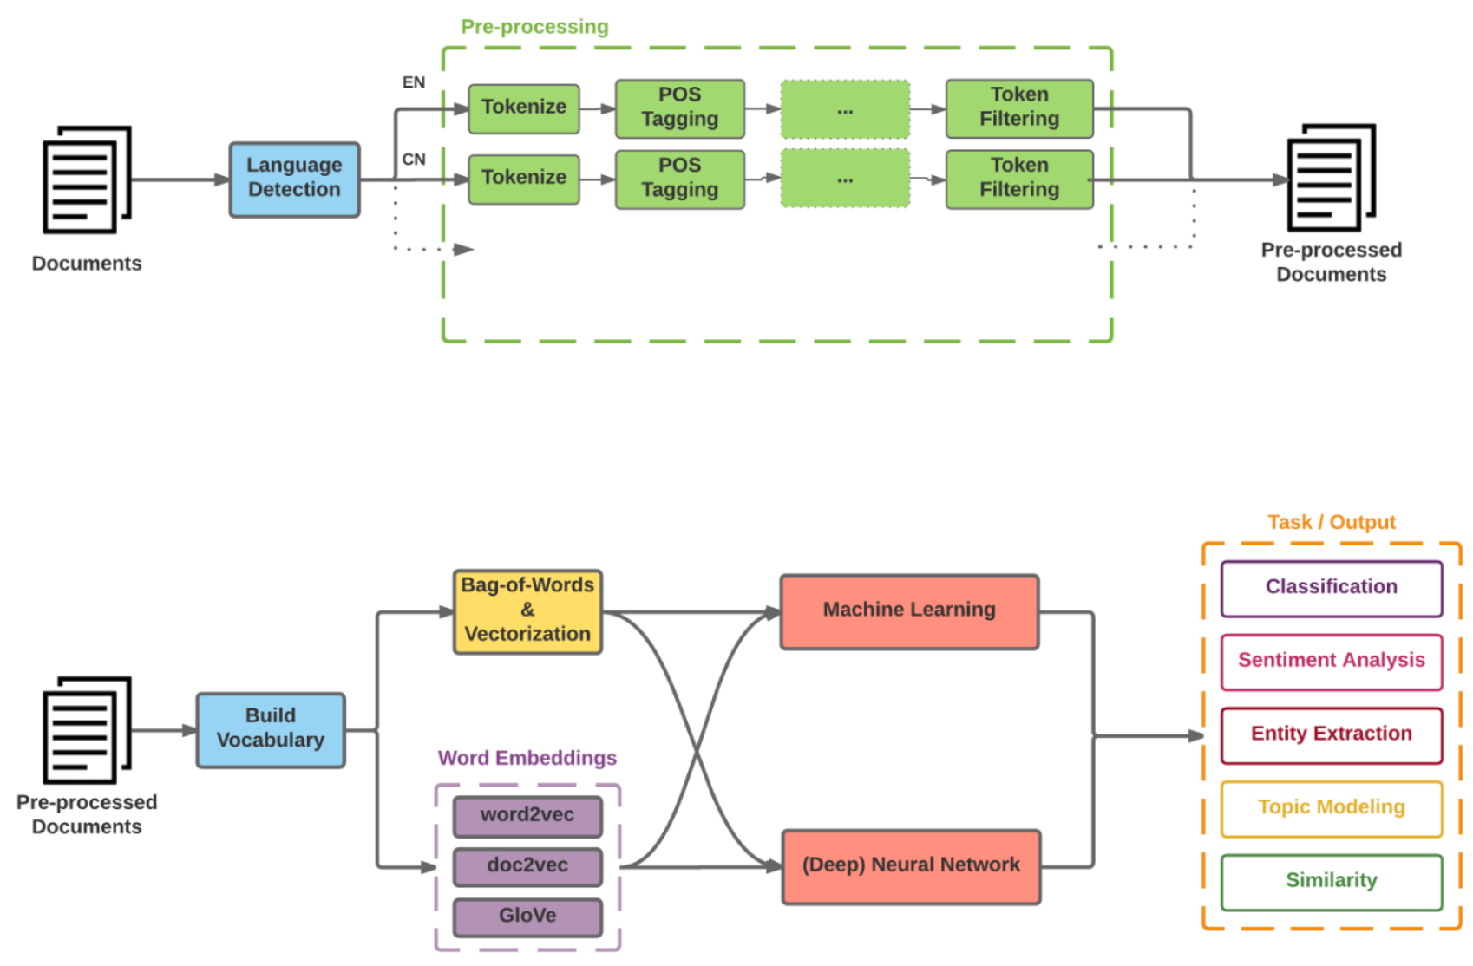
Modern NLP Pipeline
Source: https://github.com/fortiema/talks/blob/master/opendata2016sh/pragmatic-nlp-opendata2016sh.pdf

Slide 57
Modern NLP Pipeline
Source: http://mattfortier.me/2017/01/31/nlp-intro-pt-1-overview/

Slide 58
Deep Learning NLP
Source: http://mattfortier.me/2017/01/31/nlp-intro-pt-1-overview/

Slide 59

Text Classification
Source: https://developers.google.com/machine-learning/guides/text-classification/

Slide 60
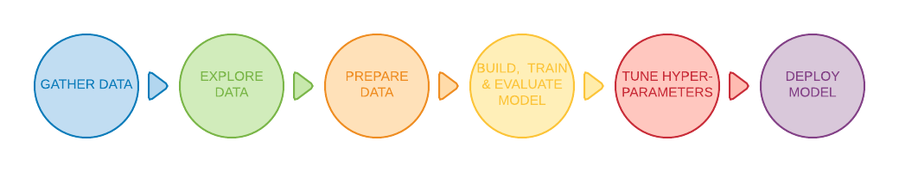
Text Classification Workflow
Step 1: Gather Data
Step 2: Explore Your Data
Step 2.5: Choose a Model*
Step 3: Prepare Your Data
Step 4: Build, Train, and Evaluate Your Model
Step 5: Tune Hyperparameters
Step 6: Deploy Your Model
Source: https://developers.google.com/machine-learning/guides/text-classification/

Slide 61
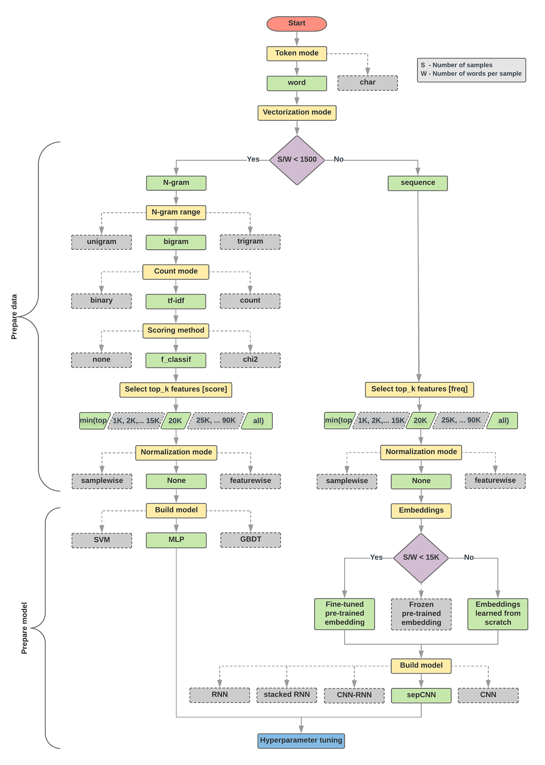
Text Classification Flowchart
Source: https://developers.google.com/machine-learning/guides/text-classification/step-2-5

Slide 62
Text Classification S/W<1500: N-gram
Source: https://developers.google.com/machine-learning/guides/text-classification/step-2-5

Slide 63
Text Classification S/W>=1500: Sequence
Source: https://developers.google.com/machine-learning/guides/text-classification/step-2-5

Slide 64
Step 2.5: Choose a Model Samples/Words < 1500 150,000/100 = 1500
IMDb review dataset, the samples/words-per-sample ratio is ~ 144
Source: https://developers.google.com/machine-learning/guides/text-classification/step-2-5

Slide 65
Step 2.5: Choose a Model Samples/Words < 15,000 1,500,000/100 = 15,000
Source: https://developers.google.com/machine-learning/guides/text-classification/step-2-5

Slide 66
Step 3: Prepare Your Data
Texts: T1: ’The mouse ran up the clock' T2: ’The mouse ran down’
Token Index:
{'the': 1, 'mouse’: 2, 'ran': 3, 'up': 4, 'clock': 5, 'down': 6,}.
NOTE: 'the' occurs most frequently, so the index value of 1 is assigned to it.
Some libraries reserve index 0 for unknown tokens, as is the case here.
Sequence of token indexes: T1: ‘The mouse ran up the clock’ = [1, 2, 3, 4, 1, 5]
T1: ’The mouse ran down’ = [1, 2, 3, 6]
Source: https://developers.google.com/machine-learning/guides/text-classification/step-3

Slide 67
One-hot encoding
'The mouse ran up the clock’ =
[ [0, 1, 0, 0, 0, 0, 0], [0, 0, 1, 0, 0, 0, 0], [0, 0, 0, 1, 0, 0, 0], [0, 0, 0, 0, 1, 0, 0], [0, 1, 0, 0, 0, 0, 0], [0, 0, 0, 0, 0, 1, 0] ]
The mouse ran up the clock
1 2 3 4
1
5
[0, 1, 2, 3, 4, 5, 6]
Source: https://developers.google.com/machine-learning/guides/text-classification/step-3

Slide 68
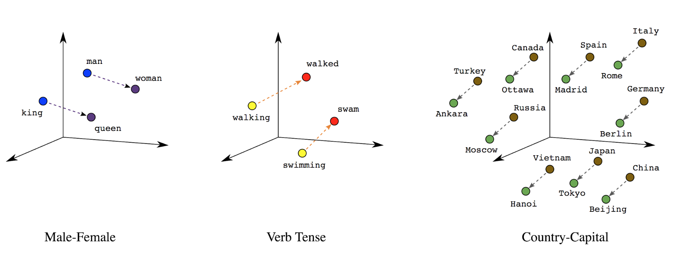
Word embeddings
Source: https://developers.google.com/machine-learning/guides/text-classification/step-3

Slide 69
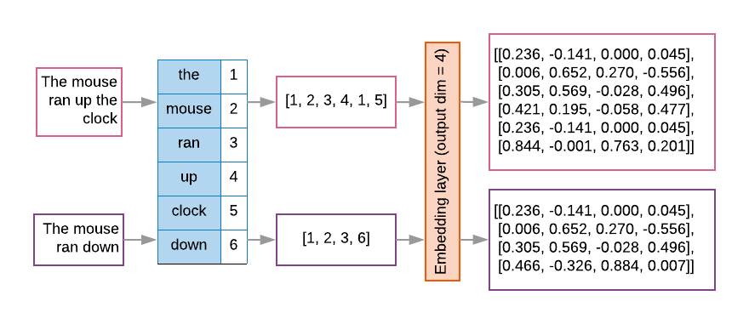
Word embeddings
Source: https://developers.google.com/machine-learning/guides/text-classification/step-3

Slide 70
Sequence to Sequence (Seq2Seq)
Source: https://google.github.io/seq2seq/

Slide 71
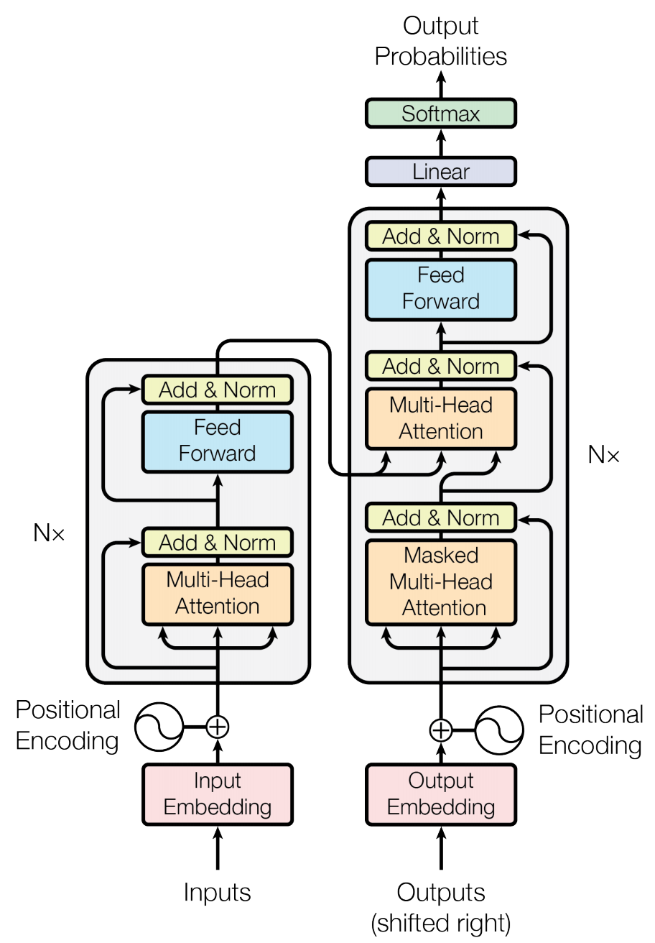
Transformer (Attention is All You Need) (Vaswani et al., 2017)
Source: Vaswani, Ashish, Noam Shazeer, Niki Parmar, Jakob Uszkoreit, Llion Jones, Aidan N. Gomez, Łukasz Kaiser, and Illia Polosukhin. "Attention is all you need." In Advances in neural information processing systems, pp. 5998-6008. 2017.

Slide 72
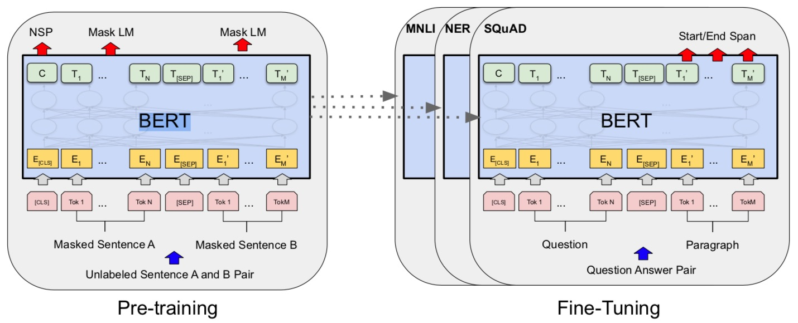
BERT: Pre-training of Deep Bidirectional Transformers for Language Understanding
BERT (Bidirectional Encoder Representations from Transformers)
Overall pre-training and fine-tuning procedures for BERT
Source: Devlin, Jacob, Ming-Wei Chang, Kenton Lee, and Kristina Toutanova (2018). "Bert: Pre-training of deep bidirectional transformers for language understanding." arXiv preprint arXiv:1810.04805.

Slide 73
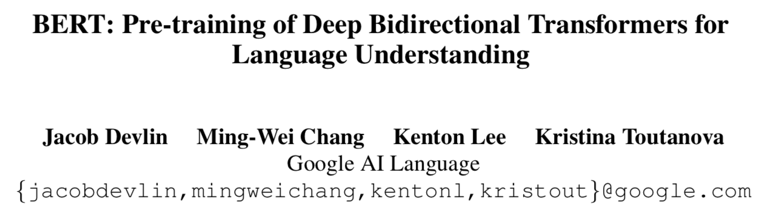
BERT: Pre-training of Deep Bidirectional Transformers for Language Understanding
Source: Devlin, Jacob, Ming-Wei Chang, Kenton Lee, and Kristina Toutanova (2018). "BERT: Pre-training of Deep Bidirectional Transformers for Language Understanding." arXiv preprint arXiv:1810.04805

Slide 74
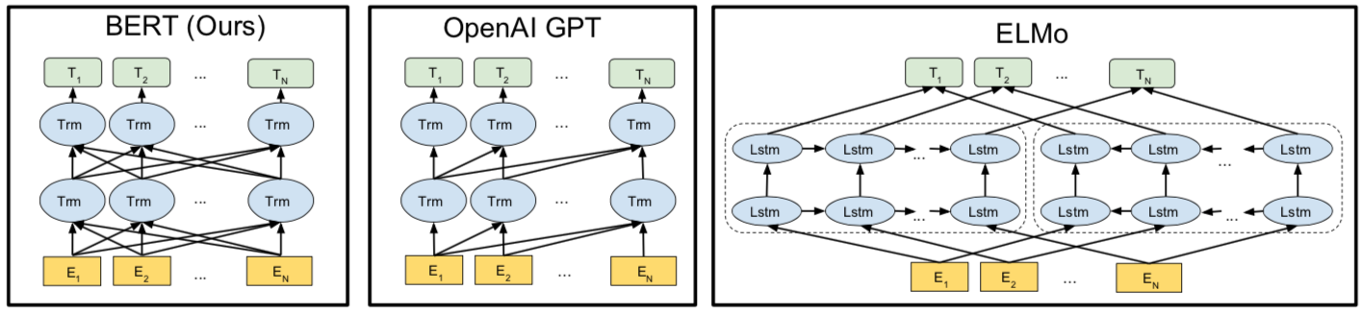
BERT Bidirectional Encoder Representations from Transformers
Pre-training model architectures
BERT uses a bidirectional Transformer.
OpenAI GPT uses a left-to-right Transformer.
ELMo uses the concatenation of independently trained left-to-right and right- to-left LSTM to generate features for downstream tasks.
Among three, only BERT representations are jointly conditioned on both left and right context in all layers.
Source: Devlin, Jacob, Ming-Wei Chang, Kenton Lee, and Kristina Toutanova (2018). "BERT: Pre-training of Deep Bidirectional Transformers for Language Understanding." arXiv preprint arXiv:1810.04805

Slide 75
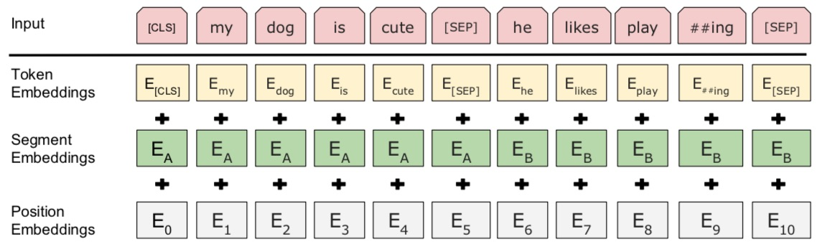
BERT: Pre-training of Deep Bidirectional Transformers for Language Understanding
BERT (Bidirectional Encoder Representations from Transformers)
BERT input representation
The input embeddings is the sum of the token embeddings, the segmentation embeddings and the position embeddings.
Source: Devlin, Jacob, Ming-Wei Chang, Kenton Lee, and Kristina Toutanova (2018). "Bert: Pre-training of deep bidirectional transformers for language understanding." arXiv preprint arXiv:1810.04805.

Slide 76
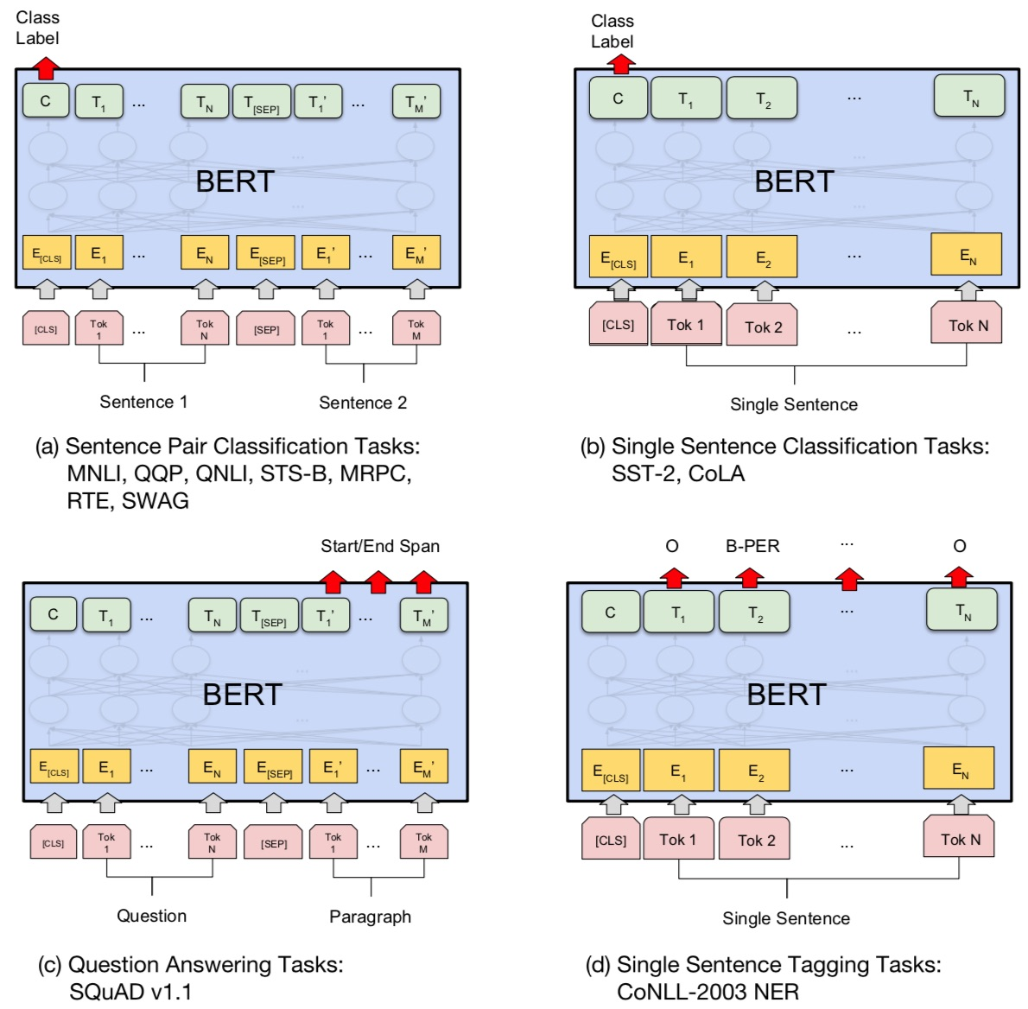
Fine-tuning BERT on NLP Tasks
Source: Devlin, Jacob, Ming-Wei Chang, Kenton Lee, and Kristina Toutanova (2018). "BERT: Pre-training of Deep Bidirectional Transformers for Language Understanding." arXiv preprint arXiv:1810.04805

Slide 77
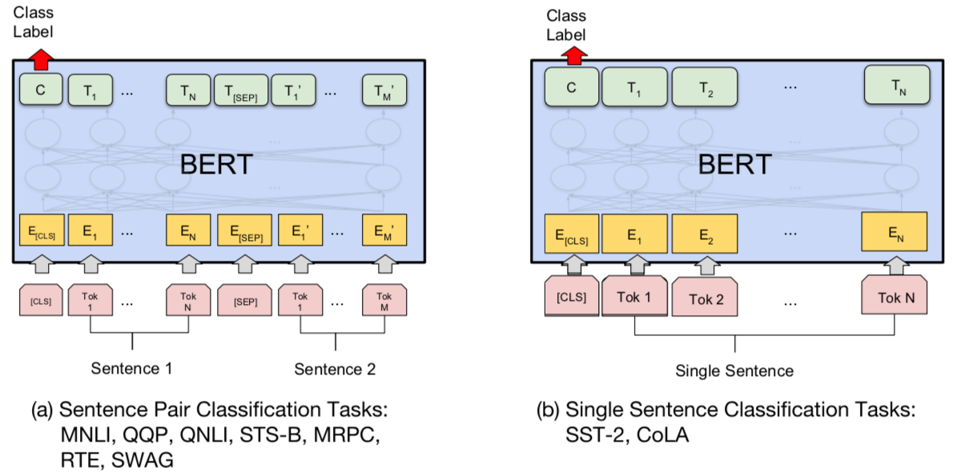
BERT Sequence-level tasks
Source: Devlin, Jacob, Ming-Wei Chang, Kenton Lee, and Kristina Toutanova (2018). "BERT: Pre-training of Deep Bidirectional Transformers for Language Understanding." arXiv preprint arXiv:1810.04805

Slide 78
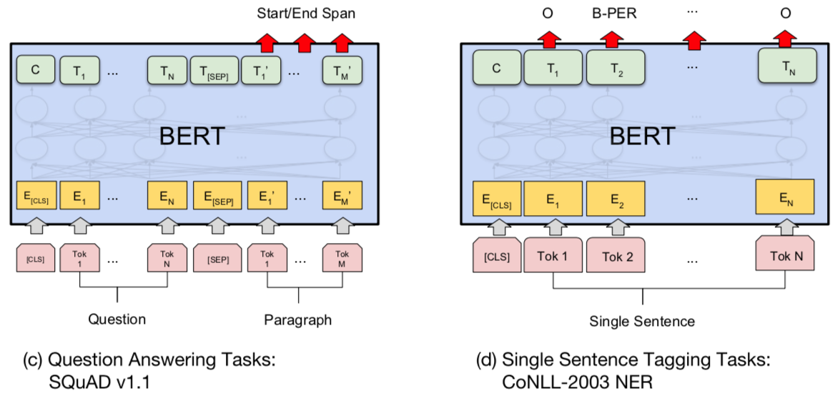
BERT Token-level tasks
Source: Devlin, Jacob, Ming-Wei Chang, Kenton Lee, and Kristina Toutanova (2018). "BERT: Pre-training of Deep Bidirectional Transformers for Language Understanding." arXiv preprint arXiv:1810.04805

Slide 79
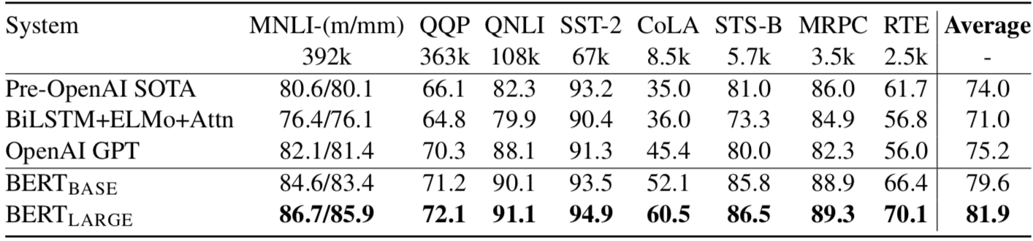
General Language Understanding Evaluation (GLUE) benchmark GLUE Test results
MNLI: Multi-Genre Natural Language Inference
QQP: Quora Question Pairs
QNLI: Question Natural Language Inference
SST-2: The Stanford Sentiment Treebank
CoLA: The Corpus of Linguistic Acceptability
STS-B:The Semantic Textual Similarity Benchmark
MRPC: Microsoft Research Paraphrase Corpus
RTE: Recognizing Textual Entailment
Source: Devlin, Jacob, Ming-Wei Chang, Kenton Lee, and Kristina Toutanova (2018). "BERT: Pre-training of Deep Bidirectional Transformers for Language Understanding." arXiv preprint arXiv:1810.04805

Slide 80
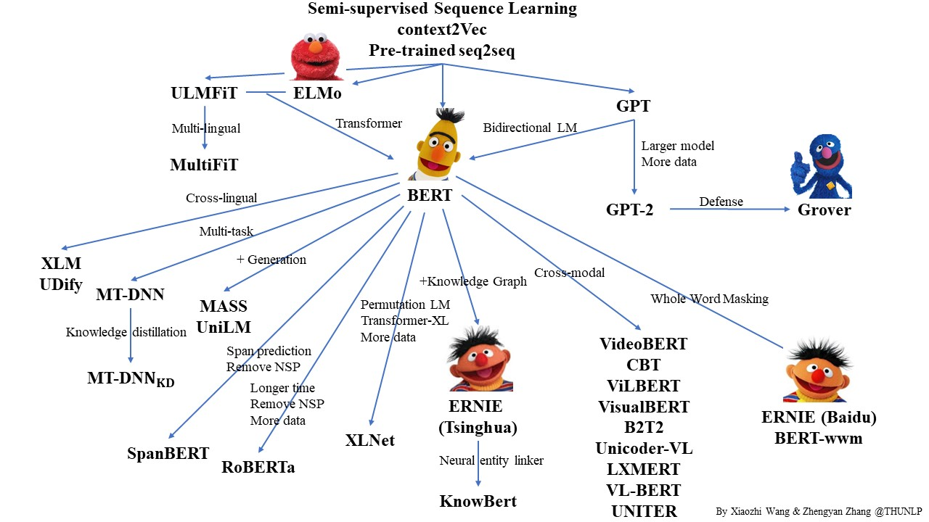
Pre-trained Language Model (PLM)
Source: https://github.com/thunlp/PLMpapers

Slide 81
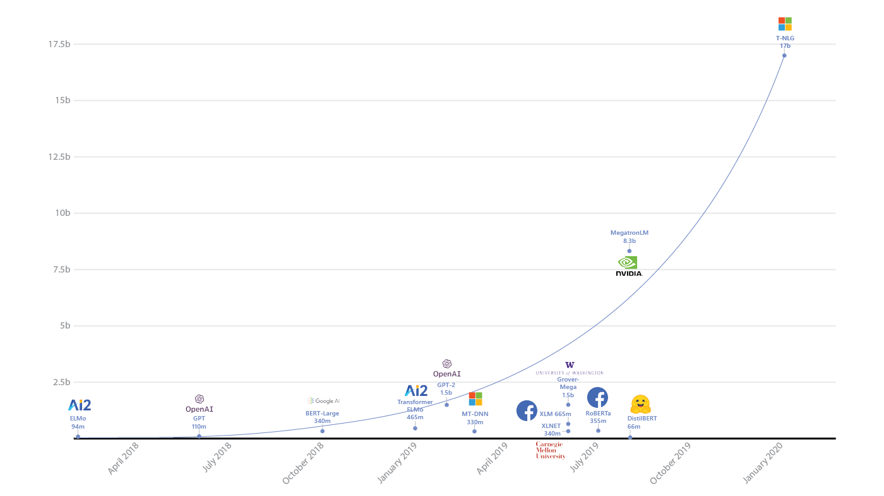
Turing Natural Language Generation (T-NLG)
T-NLG
17b
MegatronLM
8.3b
GPT-2
1.5b
BERT-Large
340m
RoBERTa
355m
DistilBERT
66m
2018
2019
2020
Source: https://www.microsoft.com/en-us/research/blog/turing-nlg-a-17-billion-parameter-language-model-by-microsoft/

Slide 82
Transformers State-of-the-art Natural Language Processing for TensorFlow 2.0 and PyTorch
Transformers
pytorch-transformers
pytorch-pretrained-bert
provides state-of-the-art general-purpose architectures
(BERT, GPT-2, RoBERTa, XLM, DistilBert, XLNet, CTRL...)
for Natural Language Understanding (NLU) and Natural Language Generation (NLG) with over 32+ pretrained models in 100+ languages and deep interoperability between TensorFlow 2.0 and PyTorch.
Source: https://github.com/huggingface/transformers

Slide 83
Transfer Learning in Natural Language Processing
Source: Sebastian Ruder, Matthew E. Peters, Swabha Swayamdipta, and Thomas Wolf (2019), "Transfer learning in natural language processing." In Proceedings of the 2019 Conference of the North American Chapter of the Association for Computational Linguistics: Tutorials, pp. 15-18.

Slide 84
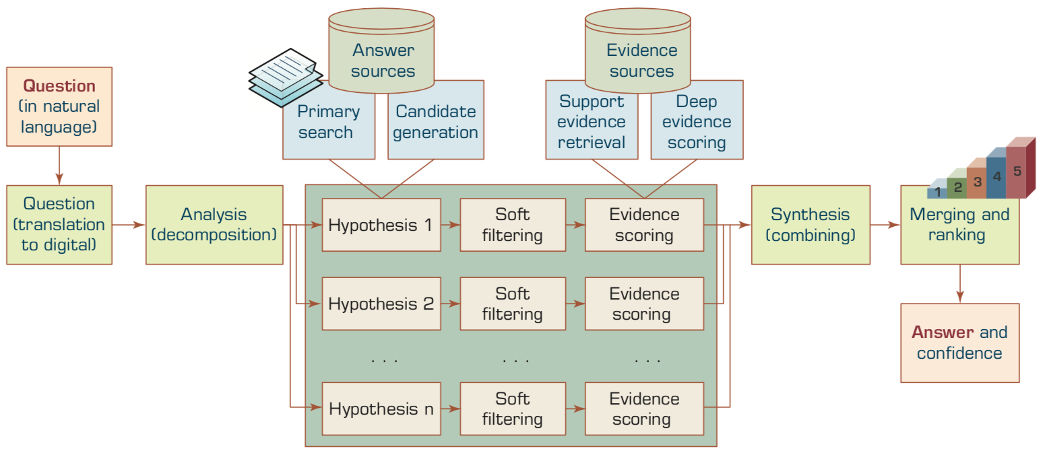
A High-Level Depiction of DeepQA Architecture
Source: Ramesh Sharda, Dursun Delen, and Efraim Turban (2017), Business Intelligence, Analytics, and Data Science: A Managerial Perspective, 4th Edition, Pearson

Slide 85
NLP Libraries and Tools

Slide 86
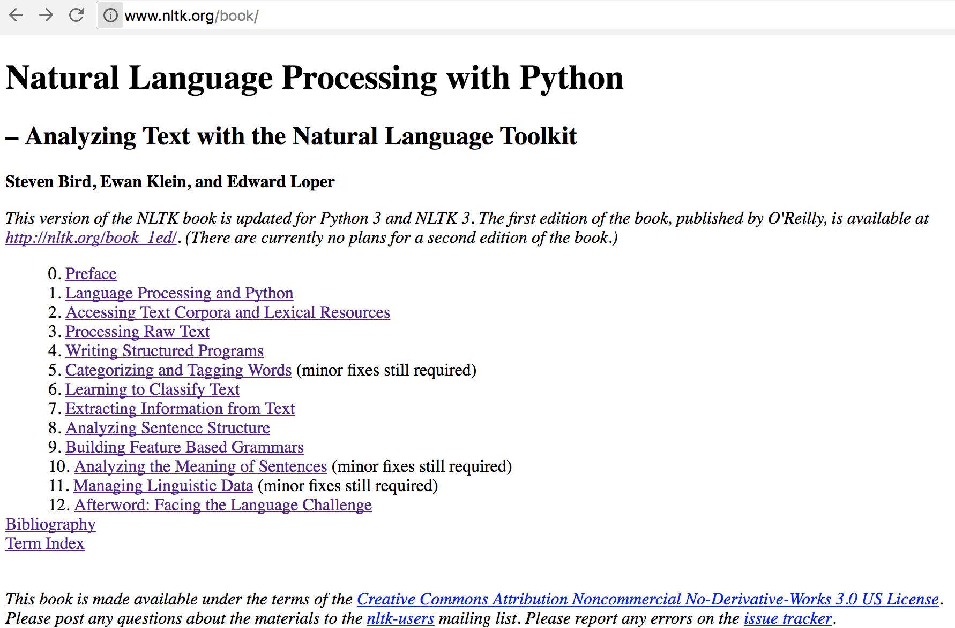
Natural Language Processing with Python – Analyzing Text with the Natural Language Toolkit
NLTK
http://www.nltk.org/book/

Slide 87
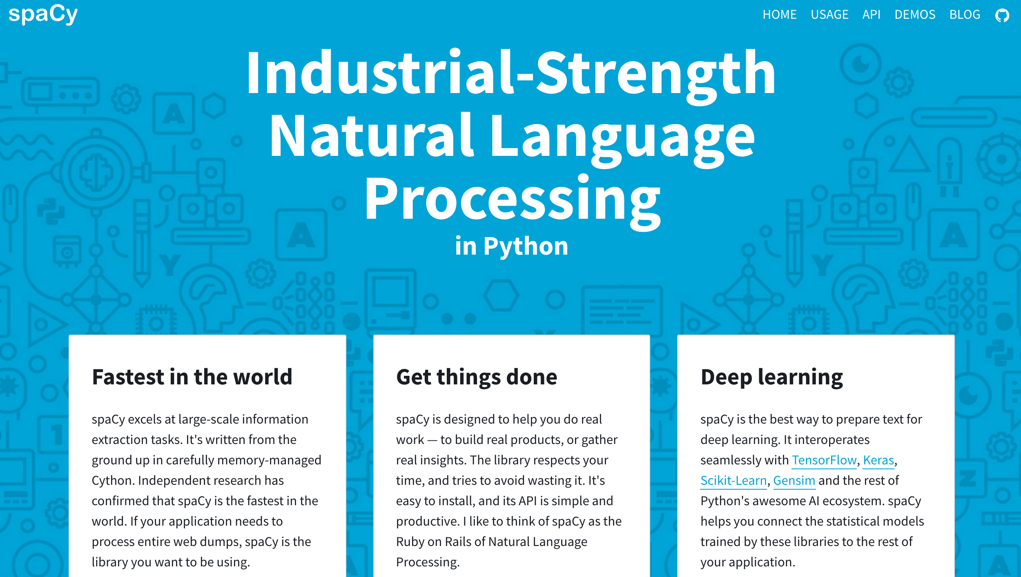
spaCy
https://spacy.io/

Slide 88
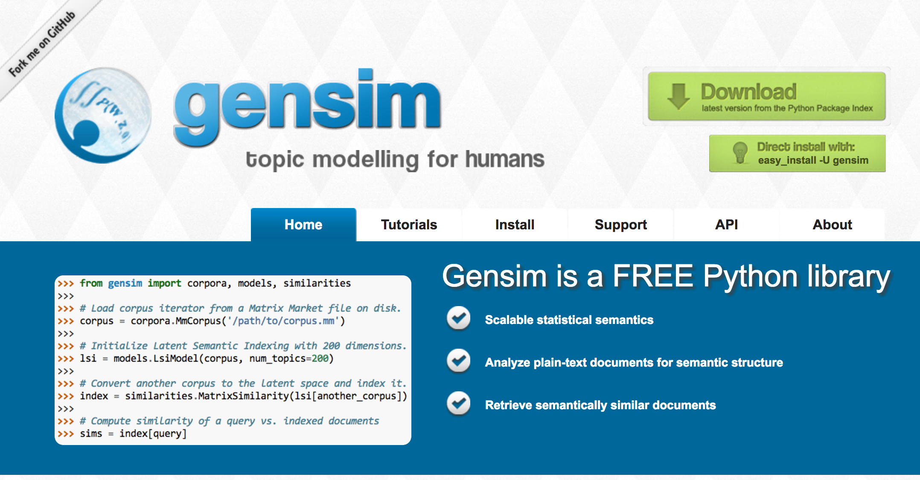
gensim
https://radimrehurek.com/gensim/

Slide 89
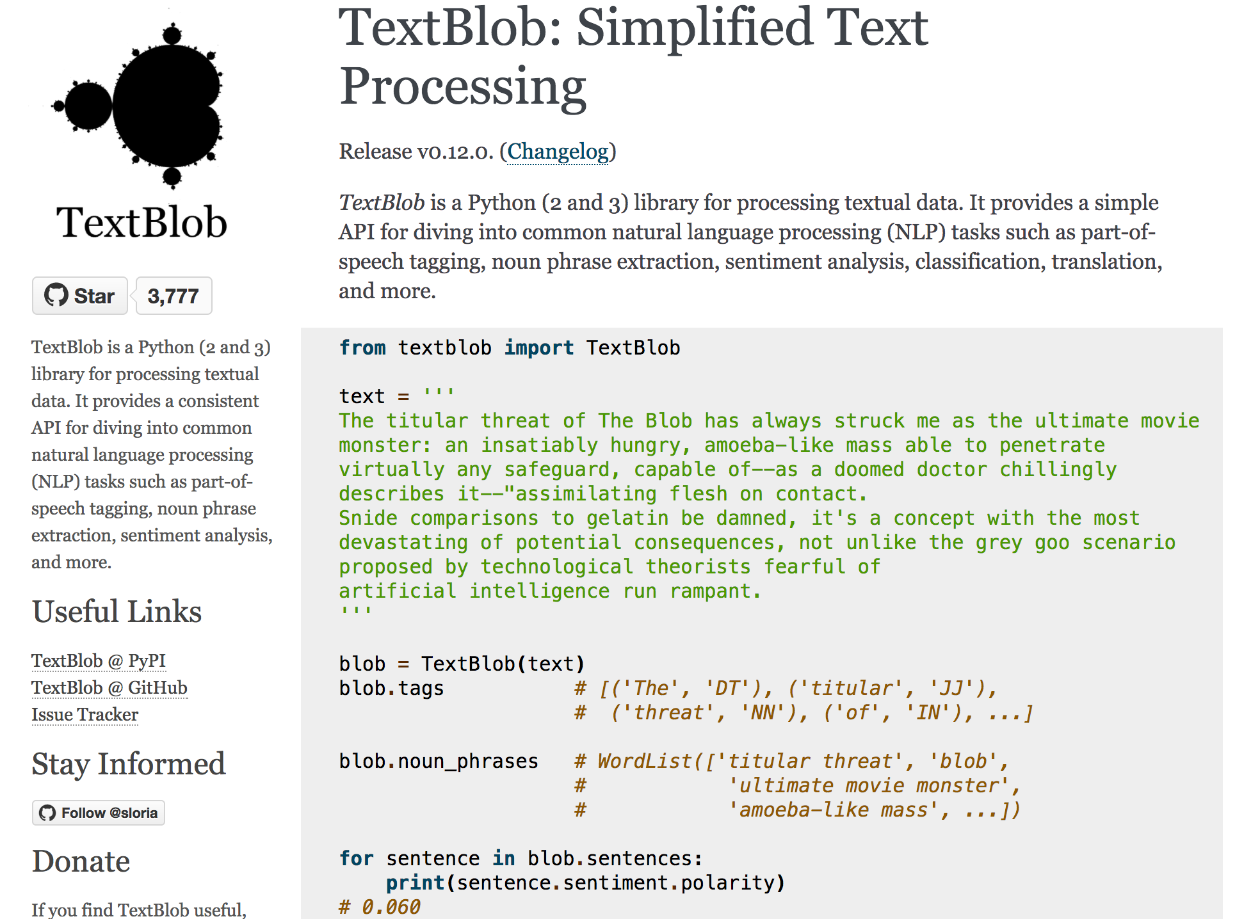
TextBlob
https://textblob.readthedocs.io

Slide 90
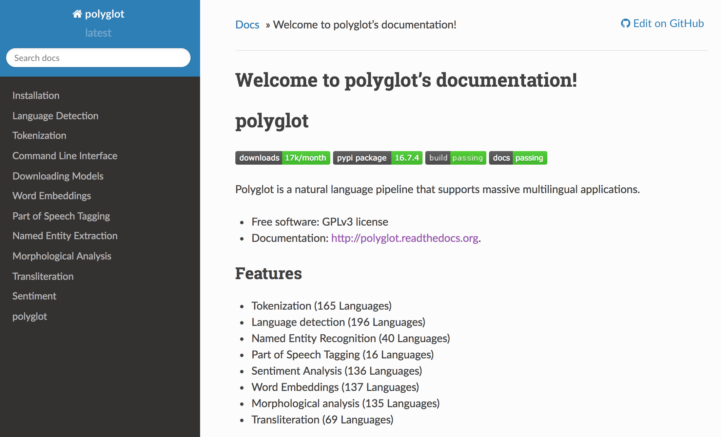
Polyglot
https://polyglot.readthedocs.io/

Slide 91
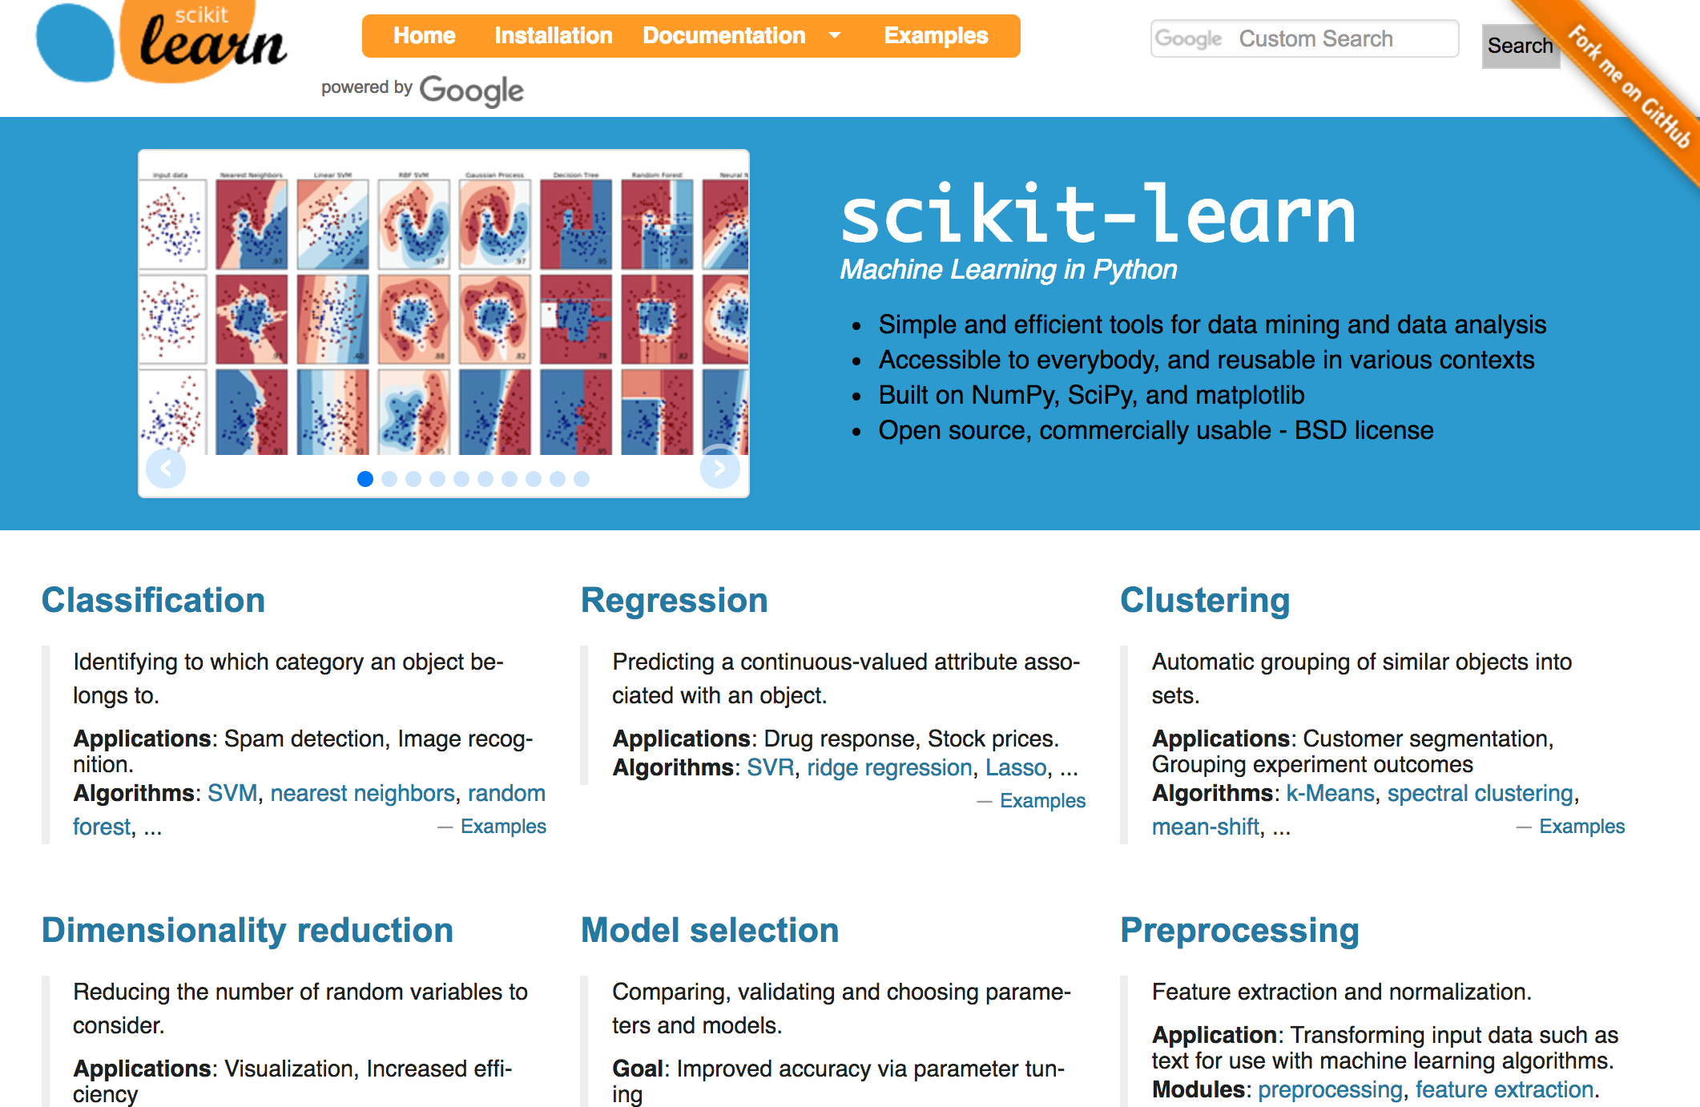
scikit-learn
http://scikit-learn.org/

Slide 92
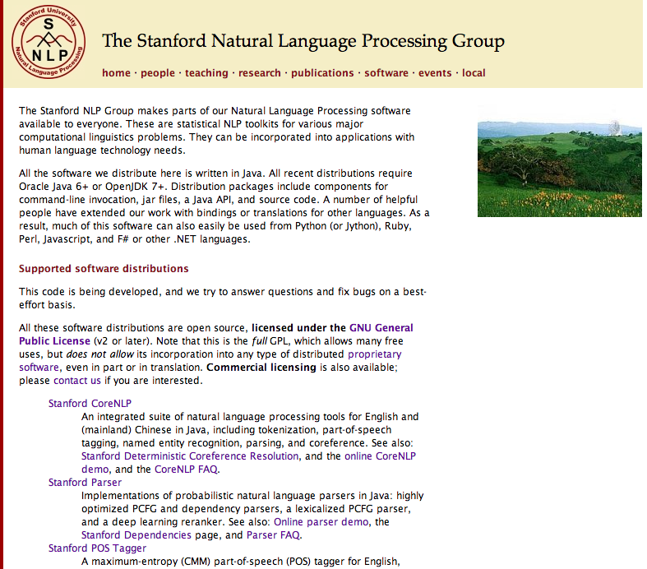
http://nlp.stanford.edu/software/index.shtml
Stanford NLP
Software

Slide 93
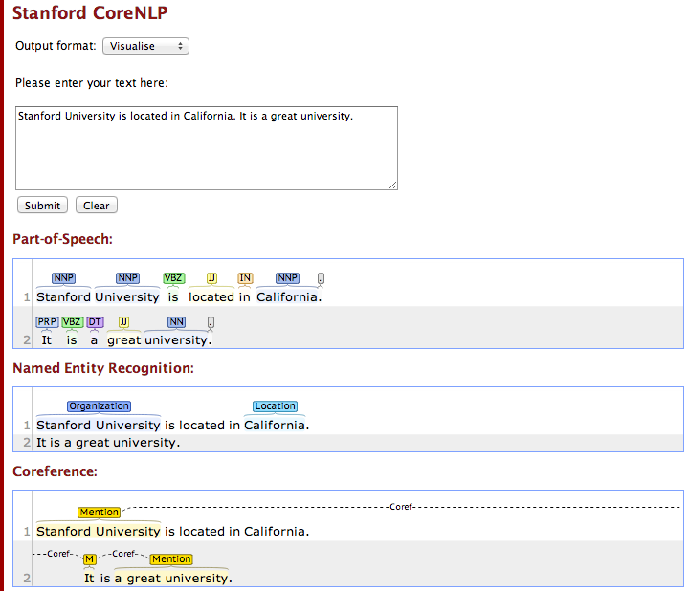
Stanford CoreNLP
http://nlp.stanford.edu:8080/corenlp/process

Slide 94
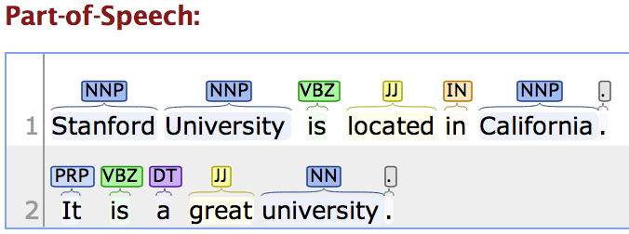
Stanford CoreNLP
http://nlp.stanford.edu:8080/corenlp/process
Stanford University is located in California. It is a great university.

Slide 95
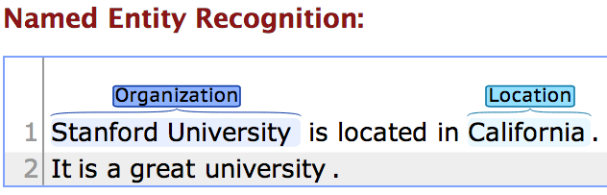
Stanford CoreNLP
http://nlp.stanford.edu:8080/corenlp/process
Stanford University is located in California. It is a great university.

Slide 96
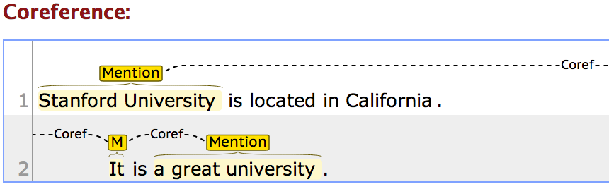
Stanford CoreNLP
http://nlp.stanford.edu:8080/corenlp/process
Stanford University is located in California. It is a great university.

Slide 97
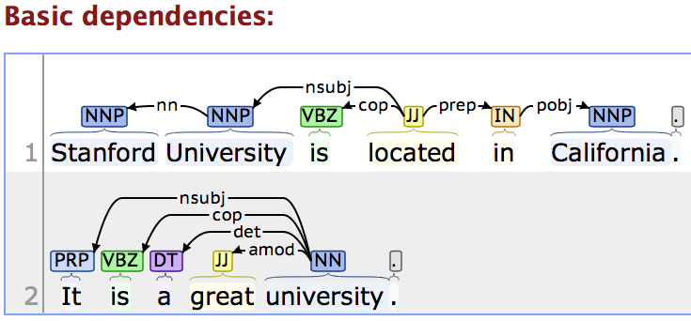
Stanford CoreNLP
http://nlp.stanford.edu:8080/corenlp/process
Stanford University is located in California. It is a great university.

Slide 98
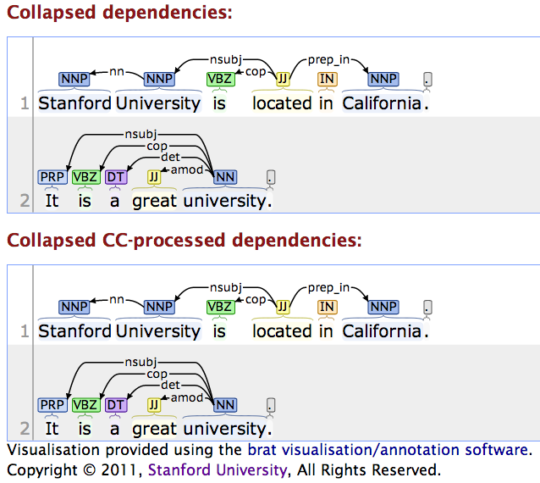
Stanford CoreNLP
http://nlp.stanford.edu:8080/corenlp/process

Slide 99
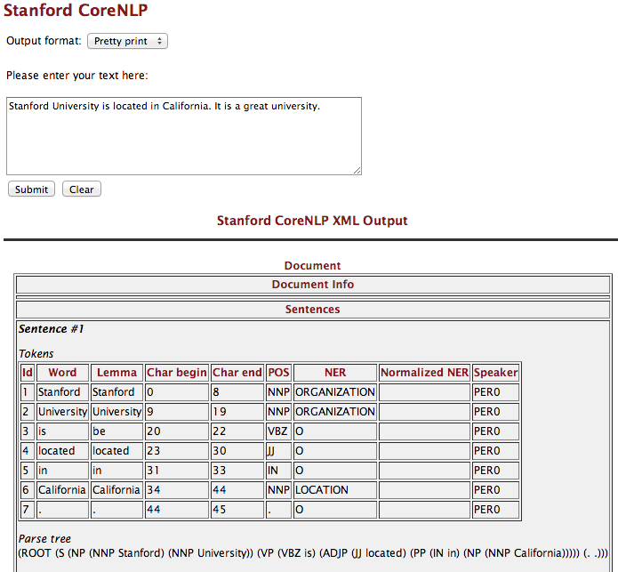
http://nlp.stanford.edu:8080/corenlp/process

Slide 100
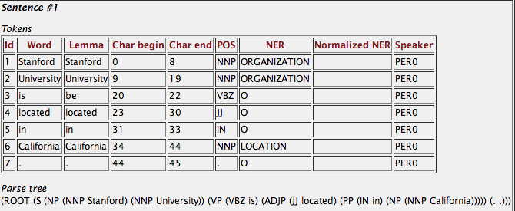
Stanford CoreNLP
http://nlp.stanford.edu:8080/corenlp/process
Stanford University is located in California. It is a great university.

Slide 101
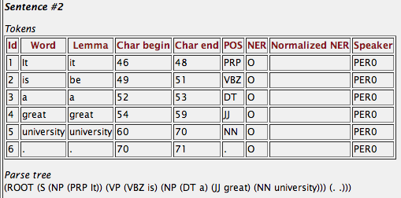
Stanford CoreNLP
http://nlp.stanford.edu:8080/corenlp/process
Stanford University is located in California. It is a great university.

Slide 102

Stanford CoreNLP
http://nlp.stanford.edu:8080/corenlp/process
Stanford University is located in California. It is a great university.

Slide 103
Tokens
Id Word Lemma Char begin Char end POS NER Normalized NER Speaker
1 Stanford Stanford 0 8 NNP ORGANIZATION PER0
2 University University 9 19 NNP ORGANIZATION PER0
3 is be 20 22 VBZ O PER0
4 located located 23 30 JJ O PER0
5 in in 31 33 IN O PER0
6 California California 34 44 NNP LOCATION PER0
7 . . 44 45 . O PER0
Parse tree
(ROOT (S (NP (NNP Stanford) (NNP University)) (VP (VBZ is) (ADJP (JJ located) (PP (IN in) (NP (NNP California))))) (. .)))
Uncollapsed dependencies
root ( ROOT-0 , located-4 )
nn ( University-2 , Stanford-1 )
nsubj ( located-4 , University-2 )
cop ( located-4 , is-3 )
prep ( located-4 , in-5 )
pobj ( in-5 , California-6 )
Collapsed dependencies
root ( ROOT-0 , located-4 )
nn ( University-2 , Stanford-1 )
nsubj ( located-4 , University-2 )
cop ( located-4 , is-3 )
prep_in ( located-4 , California-6 )
Collapsed dependencies with CC processed
root ( ROOT-0 , located-4 )
nn ( University-2 , Stanford-1 )
nsubj ( located-4 , University-2 )
cop ( located-4 , is-3 )
prep_in ( located-4 , California-6 )
Stanford CoreNLP
http://nlp.stanford.edu:8080/corenlp/process
Stanford University is located in California. It is a great university.

Slide 104

http://nlp.stanford.edu:8080/corenlp/process

Slide 105

NER for News Article
http://money.cnn.com/2014/05/02/technology/gates-microsoft-stock-sale/index.html
Bill Gates no longer Microsoft's biggest shareholder
By Patrick M. Sheridan @CNNTech May 2, 2014: 5:46 PM ET
Bill Gates sold nearly 8 million shares of Microsoft over the past two days.
NEW YORK (CNNMoney)
For the first time in Microsoft's history, founder Bill Gates is no longer its largest individual shareholder.
In the past two days, Gates has sold nearly 8 million shares of Microsoft (MSFT, Fortune 500), bringing down his total to roughly 330 million.
That puts him behind Microsoft's former CEO Steve Ballmer who owns 333 million shares.
Related: Gates reclaims title of world's richest billionaire
Ballmer, who was Microsoft's CEO until earlier this year, was one of Gates' first hires.
It's a passing of the torch for Gates who has always been the largest single owner of his company's stock. Gates now spends his time and personal fortune helping run the Bill & Melinda Gates foundation.
The foundation has spent $28.3 billion fighting hunger and poverty since its inception back in 1997.

Slide 106

Stanford Named Entity Tagger (NER)
http://nlp.stanford.edu:8080/ner/process

Slide 107

Stanford Named Entity Tagger (NER)
http://nlp.stanford.edu:8080/ner/process

Slide 108

Stanford Named Entity Tagger (NER)
http://nlp.stanford.edu:8080/ner/process

Slide 109

Stanford Named Entity Tagger (NER)
http://nlp.stanford.edu:8080/ner/process

Slide 110

Stanford Named Entity Tagger (NER)
http://nlp.stanford.edu:8080/ner/process

Slide 111

Stanford Named Entity Tagger (NER)
http://nlp.stanford.edu:8080/ner/process

Slide 112


Classifier: english.muc.7class.distsim.crf.ser.gz
Classifier: english.all.3class.distsim.crf.ser.gz

Slide 113
Stanford Named Entity Tagger (NER)
http://nlp.stanford.edu:8080/ner/process
Stanford NER Output Format: inlineXML
Bill Gates no longer <ORGANIZATION>Microsoft</ORGANIZATION>'s biggest shareholder By <PERSON>Patrick M. Sheridan</PERSON> @CNNTech <DATE>May 2, 2014</DATE>: 5:46 PM ET Bill Gates sold nearly 8 million shares of <ORGANIZATION>Microsoft</ORGANIZATION> over the past two days. <LOCATION>NEW YORK</LOCATION> (CNNMoney) For the first time in <ORGANIZATION>Microsoft</ORGANIZATION>'s history, founder <PERSON>Bill Gates</PERSON> is no longer its largest individual shareholder. In the <DATE>past two days</DATE>, Gates has sold nearly 8 million shares of <ORGANIZATION>Microsoft</ORGANIZATION> (<ORGANIZATION>MSFT</ORGANIZATION>, Fortune 500), bringing down his total to roughly 330 million. That puts him behind <ORGANIZATION>Microsoft</ORGANIZATION>'s former CEO <PERSON>Steve Ballmer</PERSON> who owns 333 million shares. Related: Gates reclaims title of world's richest billionaire <PERSON>Ballmer</PERSON>, who was <ORGANIZATION>Microsoft</ORGANIZATION>'s CEO until <DATE>earlier this year</DATE>, was one of Gates' first hires. It's a passing of the torch for Gates who has always been the largest single owner of his company's stock. Gates now spends his time and personal fortune helping run the <ORGANIZATION>Bill & Melinda Gates</ORGANIZATION> foundation. The foundation has spent <MONEY>$28.3 billion</MONEY> fighting hunger and poverty since its inception back in <DATE>1997</DATE>.

Slide 114
Stanford Named Entity Tagger (NER)
http://nlp.stanford.edu:8080/ner/process
Stanford NER Output Format: slashTags
Bill/O Gates/O no/O longer/O Microsoft/ORGANIZATION's/O biggest/O shareholder/O By/O Patrick/PERSON M./PERSON Sheridan/PERSON @CNNTech/O May/DATE 2/DATE,/DATE 2014/DATE:/O 5:46/O PM/O ET/O Bill/O Gates/O sold/O nearly/O 8/O million/O shares/O of/O Microsoft/ORGANIZATION over/O the/O past/O two/O days/O./O NEW/LOCATION YORK/LOCATION -LRB-/OCNNMoney/O-RRB-/O For/O the/O first/O time/O in/O Microsoft/ORGANIZATION's/O history/O,/O founder/O Bill/PERSON Gates/PERSON is/O no/O longer/O its/O largest/O individual/O shareholder/O./O In/O the/O past/DATE two/DATE days/DATE,/O Gates/O has/O sold/O nearly/O 8/O million/O shares/O of/O Microsoft/ORGANIZATION -LRB-/OMSFT/ORGANIZATION,/O Fortune/O 500/O-RRB-/O,/O bringing/O down/O his/O total/O to/O roughly/O 330/O million/O./O That/O puts/O him/O behind/O Microsoft/ORGANIZATION's/O former/O CEO/O Steve/PERSON Ballmer/PERSON who/O owns/O 333/O million/O shares/O./O Related/O:/O Gates/O reclaims/O title/O of/O world/O's/O richest/O billionaire/O Ballmer/PERSON,/O who/O was/O Microsoft/ORGANIZATION's/O CEO/O until/O earlier/DATE this/DATE year/DATE,/O was/O one/O of/O Gates/O'/O first/O hires/O./O It/O's/O a/O passing/O of/O the/O torch/O for/O Gates/O who/O has/O always/O been/O the/O largest/O single/O owner/O of/O his/O company/O's/O stock/O./O Gates/O now/O spends/O his/O time/O and/O personal/O fortune/O helping/O run/O the/O Bill/ORGANIZATION &/ORGANIZATION Melinda/ORGANIZATION Gates/ORGANIZATION foundation/O./O The/O foundation/O has/O spent/O $/MONEY28.3/MONEY billion/MONEY fighting/O hunger/O and/O poverty/O since/O its/O inception/O back/O in/O 1997/DATE./O

Slide 115


CKIP 中研院中文斷詞系統
http://ckipsvr.iis.sinica.edu.tw/
歐巴馬是美國的一位總統
歐巴馬(Nb) 是(SHI) 美國(Nc) 的(DE) 一(Neu) 位(Nf) 總統(Na)

Slide 116
Vector Representations of Words Word Embeddings Word2Vec GloVe

Slide 117
Modern NLP Pipeline
Source: https://github.com/fortiema/talks/blob/master/opendata2016sh/pragmatic-nlp-opendata2016sh.pdf

Slide 118
Facebook Research FastText
Pre-trained word vectors
Word2Vec
wiki.zh.vec (861MB)
332647 word
300 vec
Pre-trained word vectors for 90 languages, trained on Wikipedia using fastText.
These vectors in dimension 300 were obtained using the skip-gram model with default parameters.
https://github.com/facebookresearch/fastText/blob/master/pretrained-vectors.md
Source: Bojanowski, Piotr, Edouard Grave, Armand Joulin, and Tomas Mikolov. "Enriching word vectors with subword information." arXiv preprint arXiv:1607.04606 (2016).

Slide 119


Facebook Research FastText Word2Vec: wiki.zh.vec (861MB) (332647 word 300 vec)
https://github.com/facebookresearch/fastText/blob/master/pretrained-vectors.md

Slide 120
Word Embeddings in LSTM RNN
Source: https://avisingh599.github.io/deeplearning/visual-qa/

Slide 121

NLP Tools: spaCy vs. NLTK
Source: https://spacy.io/docs/api/

Slide 122
Natural Language Processing (NLP) spaCy
Tokenization
Part-of-speech tagging
Sentence segmentation
Dependency parsing
Entity Recognition
Integrated word vectors
Sentiment analysis
Coreference resolution
Source: https://spacy.io/docs/api/

Slide 123
spaCy: Fastest Syntactic Parser
SYSTEM | LANGUAGE | ACCURACY | SPEED (WPS)
spaCy | Cython | 91.8 | 13,963
ClearNLP | Java | 91.7 | 10,271
CoreNLP | Java | 89.6 | 8,602
MATE | Java | 92.5 | 550
Turbo | C++ | 92.4 | 349
Source: https://spacy.io/docs/api/

Slide 124
Processing Speed of NLP libraries
 | ABSOLUTE (MS PER DOC) |  |  | RELATIVE (TO SPACY)
SYSTEM | TOKENIZE | TAG | PARSE | TOKENIZE | TAG | PARSE
spaCy | 0.2ms | 1ms | 19ms | 1x | 1x | 1x
CoreNLP | 2ms | 10ms | 49ms | 10x | 10x | 2.6x
ZPar | 1ms | 8ms | 850ms | 5x | 8x | 44.7x
NLTK | 4ms | 443ms | n/a | 20x | 443x | n/a
Source: https://spacy.io/docs/api/

Slide 125
Google SyntaxNet (2016): Best Syntactic Dependency Parsing Accuracy
SYSTEM | NEWS | WEB | QUESTIONS
spaCy | 92.8 | n/a | n/a
Parsey McParseface | 94.15 | 89.08 | 94.77
Martins et al. (2013) | 93.10 | 88.23 | 94.21
Zhang and McDonald (2014) | 93.32 | 88.65 | 93.37
Weiss et al. (2015) | 93.91 | 89.29 | 94.17
Andor et al. (2016) | 94.44 | 90.17 | 95.40
Source: https://spacy.io/docs/api/

Slide 126
Named Entity Recognition (NER)
SYSTEM | PRECISION | RECALL | F-MEASURE
spaCy | 0.7240 | 0.6514 | 0.6858
CoreNLP | 0.7914 | 0.7327 | 0.7609
NLTK | 0.5136 | 0.6532 | 0.5750
LingPipe | 0.5412 | 0.5357 | 0.5384

Slide 127
Text Analytics with Python

Slide 128

Source: https://www.python.org/community/logos/

Slide 129

spaCy: Natural Language Processing
https://spacy.io/

Slide 130

Python in Google Colab (Python101)
https://colab.research.google.com/drive/1FEG6DnGvwfUbeo4zJ1zTunjMqf2RkCrT
https://tinyurl.com/aintpupython101

Slide 131

Python in Google Colab (Python101)
https://colab.research.google.com/drive/1FEG6DnGvwfUbeo4zJ1zTunjMqf2RkCrT
https://tinyurl.com/aintpupython101

Slide 132

Python in Google Colab (Python101)
https://colab.research.google.com/drive/1FEG6DnGvwfUbeo4zJ1zTunjMqf2RkCrT
https://tinyurl.com/aintpupython101

Slide 133

Python in Google Colab (Python101)
https://colab.research.google.com/drive/1FEG6DnGvwfUbeo4zJ1zTunjMqf2RkCrT
https://tinyurl.com/aintpupython101

Slide 134

Python in Google Colab (Python101)
https://colab.research.google.com/drive/1FEG6DnGvwfUbeo4zJ1zTunjMqf2RkCrT
https://tinyurl.com/aintpupython101

Slide 135

Python in Google Colab (Python101)
https://colab.research.google.com/drive/1FEG6DnGvwfUbeo4zJ1zTunjMqf2RkCrT
https://tinyurl.com/aintpupython101

Slide 136
Python in Google Colab (Python101)
https://colab.research.google.com/drive/1FEG6DnGvwfUbeo4zJ1zTunjMqf2RkCrT
https://tinyurl.com/aintpupython101

Slide 137

MONPA 罔拍： 正體中文斷詞、詞性標註以及命名實體辨識的多任務模型
https://tinyurl.com/aintpupython101

Slide 138

jieba words = jieba.cut(sentence)
https://tinyurl.com/aintpupython101

Slide 139

NLP Benchmark Datasets
Source: Amirsina Torfi, Rouzbeh A. Shirvani, Yaser Keneshloo, Nader Tavvaf, and Edward A. Fox (2020). "Natural Language Processing Advancements By Deep Learning: A Survey." arXiv preprint arXiv:2003.01200.

Slide 140
Summary
Text Analytics and Text Mining
Natural Language Processing (NLP)
Text Analytics with Python

Slide 141
References
Ramesh Sharda, Dursun Delen, and Efraim Turban (2017), Business Intelligence, Analytics, and Data Science: A Managerial Perspective, 4th Edition, Pearson.
Dipanjan Sarkar (2019), Text Analytics with Python: A Practitioner’s Guide to Natural Language Processing, Second Edition. APress.
Benjamin Bengfort, Rebecca Bilbro, and Tony Ojeda (2018), Applied Text Analysis with Python: Enabling Language-Aware Data Products with Machine Learning, O’Reilly.
Charu C. Aggarwal (2018), Machine Learning for Text, Springer.
Gabe Ignatow and Rada F. Mihalcea (2017), An Introduction to Text Mining: Research Design, Data Collection, and Analysis, SAGE Publications.
Rajesh Arumugam (2018), Hands-On Natural Language Processing with Python: A practical guide to applying deep learning architectures to your NLP applications, Packt.
Jake VanderPlas (2016), Python Data Science Handbook: Essential Tools for Working with Data, O'Reilly Media.
Devlin, Jacob, Ming-Wei Chang, Kenton Lee, and Kristina Toutanova (2018). "BERT: Pre-training of Deep Bidirectional Transformers for Language Understanding." arXiv preprint arXiv:1810.04805.
Christopher D. Manning and Hinrich Schütze (1999), Foundations of Statistical Natural Language Processing, The MIT Press.
Bruce Croft, Donald Metzler, and Trevor Strohman (2008), Search Engines: Information Retrieval in Practice, Addison Wesley, http://www.search-engines-book.com/
Steven Bird, Ewan Klein and Edward Loper (2009), Natural Language Processing with Python, O'Reilly Media, http://www.nltk.org/book/ , http://www.nltk.org/book_1ed/
Bing Liu (2009), Web Data Mining: Exploring Hyperlinks, Contents, and Usage Data, Springer.
The Super Duper NLP Repo, https://notebooks.quantumstat.com/
Min-Yuh Day (2020), Python 101, https://tinyurl.com/aintpupython101

Slide 142
Q & A
自然語言處理核心技術 與文字探勘 (Core Technologies of Natural Language Processing and Text Mining)
Min-Yuh Day
戴敏育
Associate Professor
副教授
Institute of Information Management, National Taipei University
國立臺北大學 資訊管理研究所
https://web.ntpu.edu.tw/~myday
2020-09-18

